Slide 1

TRAUMI MAXILLO-FACCIALI
FACILE O DIFFICILE DIAGNOSI?

Slide 2
Prof. Dott. Mario Ireneo Sturla
Presidente AMSD Pavia FMSI
Coordinatore Sanitario Nazionale FPI
Presidente Sezione Studi e Ricerche FPI
Presidente Commissione Medica Europea EBU
Co-chairman Medical Commission WBC

Slide 3
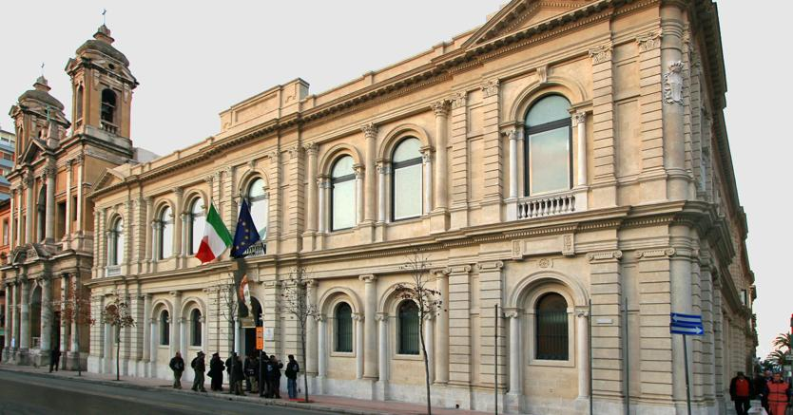
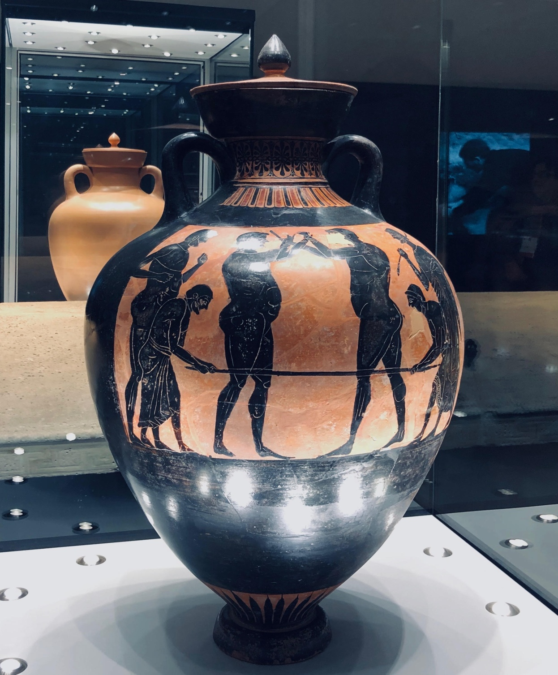
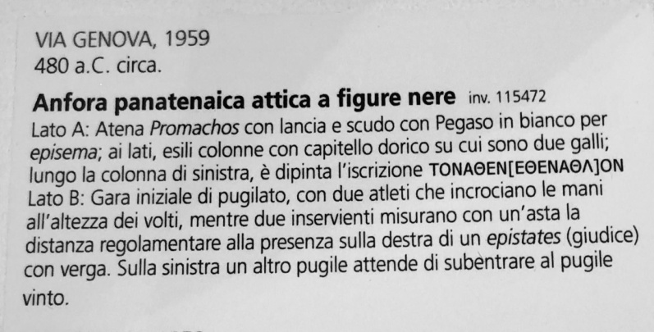
MUSEO ARCHEOLOGICO
DI TARANTO

Slide 4
APPRAISAL AND TREATMENT OF INJURIES
Boxing, being a contact sport, can often be the cause of acute injuries to soft parts of the body and/or of wounds. The gravity of acute wounds to soft parts depends on:
a) the intensity of the force applied;
b) the traumatic action occurring through a pressure or traction mechanism;
c) the range and /or angle of incidence of the blow;
d) the extent of the part of the body affected;
e) the impact surface.

Slide 5
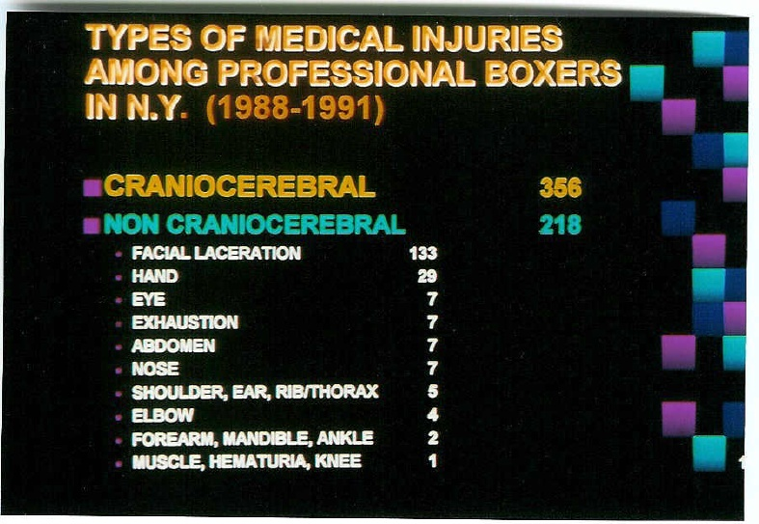

Slide 6
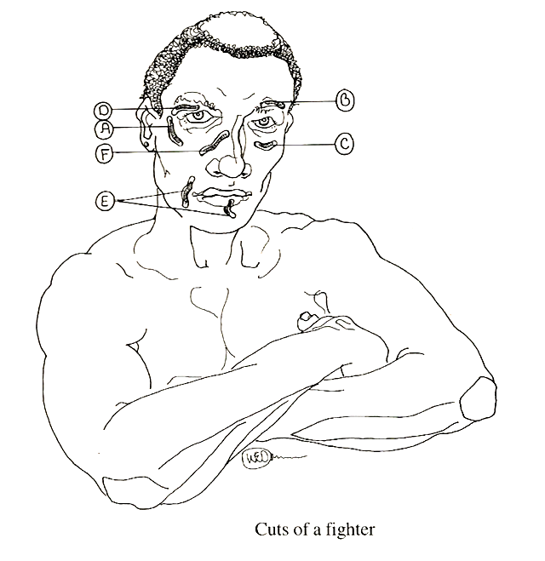
A zigomatica
B sopracciliare
C sottoorbitale
D sopraorbitale
E mandibolare
F nasale

Slide 7
PROFESSIONAL AND AMATEUR BOXING
Means of Protection
Volume and Weight of Gloves
Number of Rounds

Slide 8
TYPES OF WOUND
CONTUSIONS
SKIN IRRITATION
GRAZES
BRUISES
HAEMATOMAS

Slide 9
BODY INJURIES OR WOUNDS
LIMB WOUNDS OR INJURIES

Slide 10
LACERATED AND CONTUSED WOUNDS
Aetiopathogenesis: the dynamic force, power, speed range and angle of incidence of the blow overcome the skin’s elasticity through a compression and crushing mechanism.
The edges of the wounds appear uneven, jagged and infiltrated with blood.
The parts of the body most affected are the head and particularly the face.

Slide 11
HEAD WOUNDS
Wound located in the scalp area are the so-called “shell-shock wounds” owing to the impact of:
Head against glove
Elbow against head
Head against head
THE SCALP CONSIST OF THREE LAYERS:
SKIN
CONNECTIVE-UNDERSKIN
MUSCULAR PLANE

Slide 12
If there is an injury to the scalp, the ringside physician shall bear in mind in his appraisal the extent, depht, edges (the so-called star cut is typical) and bleending of the wound.
Blood dropping abundantly into the boxer’s eyes could prevent or limiti the boxer’s field of view, increasing the chances of his being hit by the opponent’s blows.

Slide 13
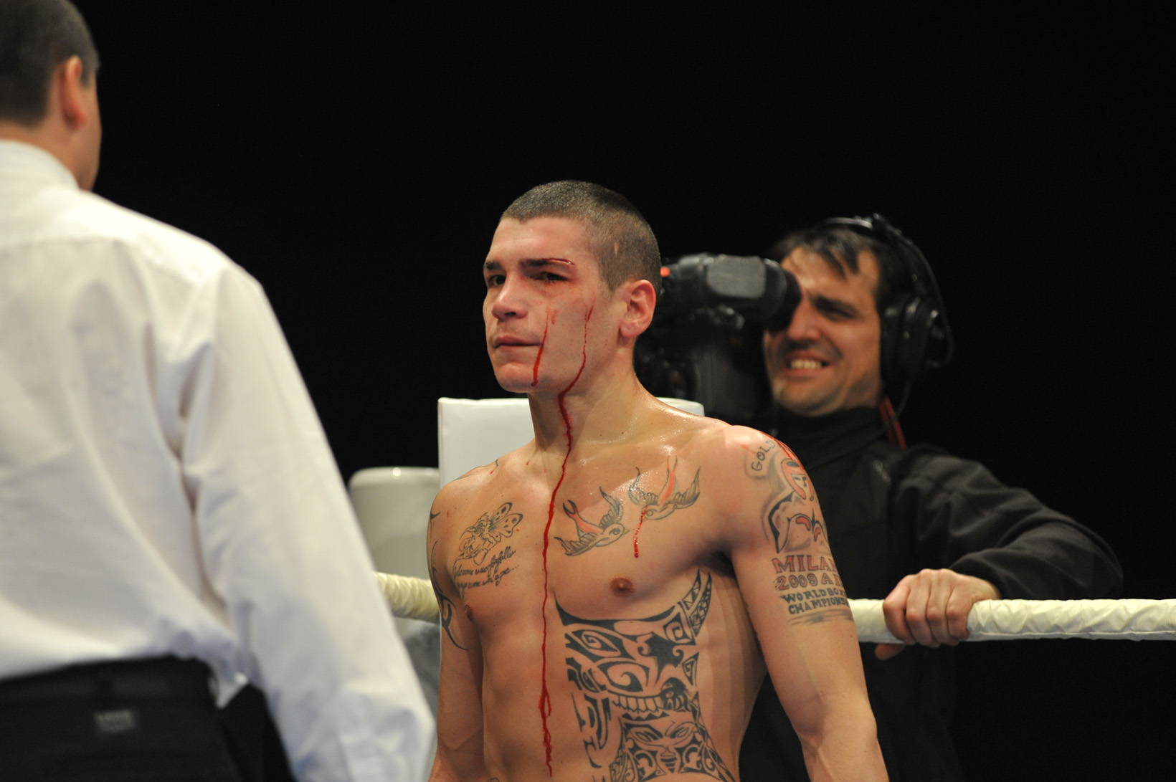

Slide 14
Lacerated and contused wounds to the supercillary arches are pareticular, in that at first glance they appear to be superficial, while in reality they frequently extend to lower layers, and even down to the bone. The cause is due to the mechanism through which they are produced, usually a traumatic action acting from the depths to the surface, making a pressor impact on the arch of the eyes, which for some boxers is particularly protruding and pointed.

Slide 15
When evaluating this type of wound, the ringside physician is required to have an indepth knowledge of the part of the body being examined, which is indeed a "locus" affected by the orbicular and frontal muscles and is particularly vascularised (branches of frontal, supraorbital, lachrymal arteries; veins lead to the upper ophthalmic nerve, superficial temporal bone and anterior facial nerve and communicate with the frontal diploe).

Slide 16
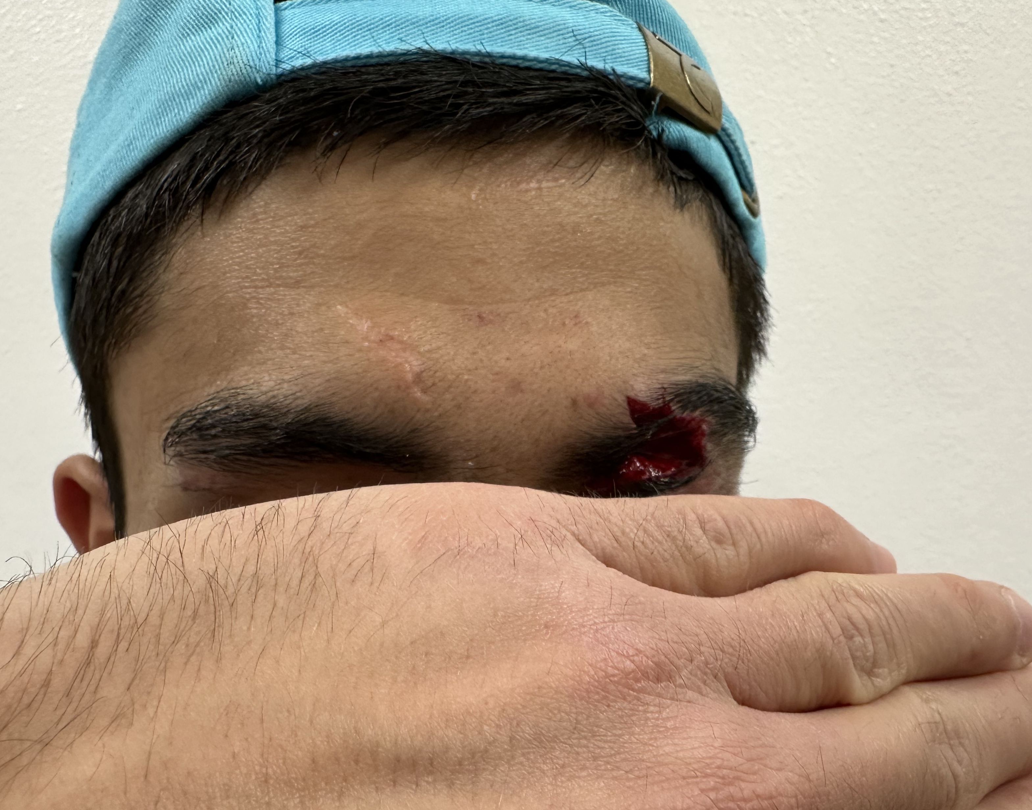

Slide 17
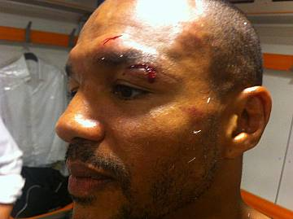

Slide 18
The same professional science and conscience are needed to examine the EYELIDS, which constitute the main means of protection for the eyeball. There is the upper and lower eyelid, which circumscribe the palpebral fissure and are formed by three main layers:
INTEGUMENTAL
PROPRIUM
MUCOUS

Slide 19
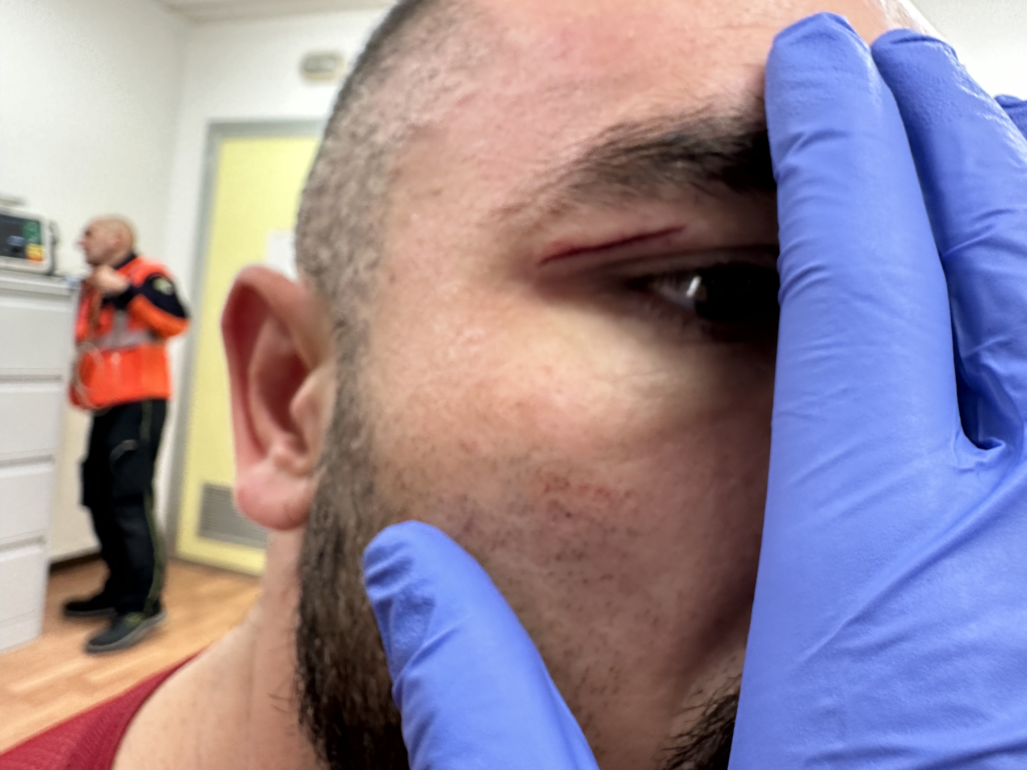

Slide 20
Special importance is attached to the upper and lower tarsal muscles, the medial palpebral ligament, the orbical muscle, the levator-muscle of the eyelid and the lachrymal CARUNCULATE. The Sports Medicine Specialist called upon to examine the wound must be equipped with surgical gloves and surgical gauze.

Slide 21
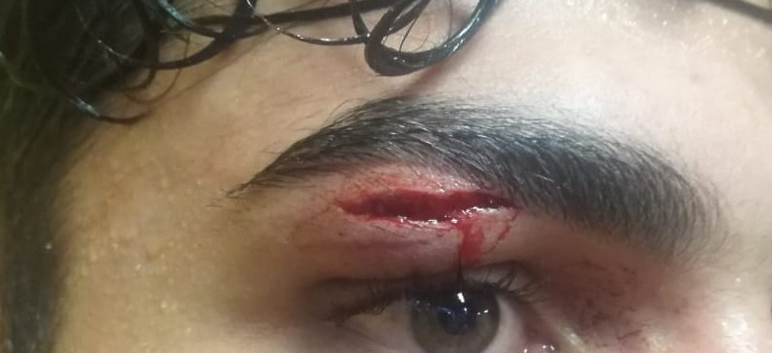

Slide 22
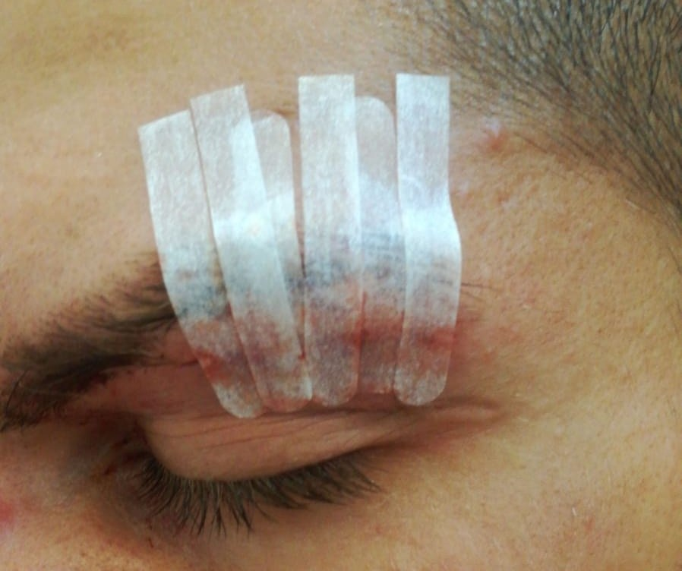

Slide 23
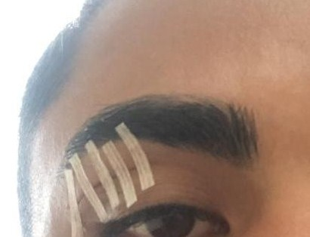

Slide 24
We should note here that the rules (AIBA, EBU and WBC) allow corners to use haemostatic (adrenaline 1/1000). Only at the conclusion of the bout can the physician stitch up the wound in a rigorously sterile setting (operating theatre or fist-aid station) after having thoroughly cleansed it, using atraumatic stitches (3 zero 5 zero).

Slide 25
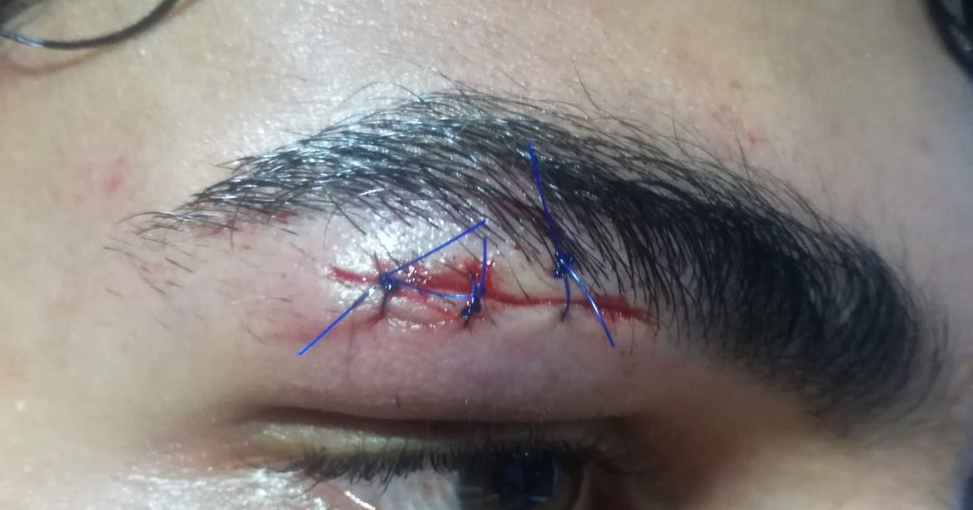

Slide 26
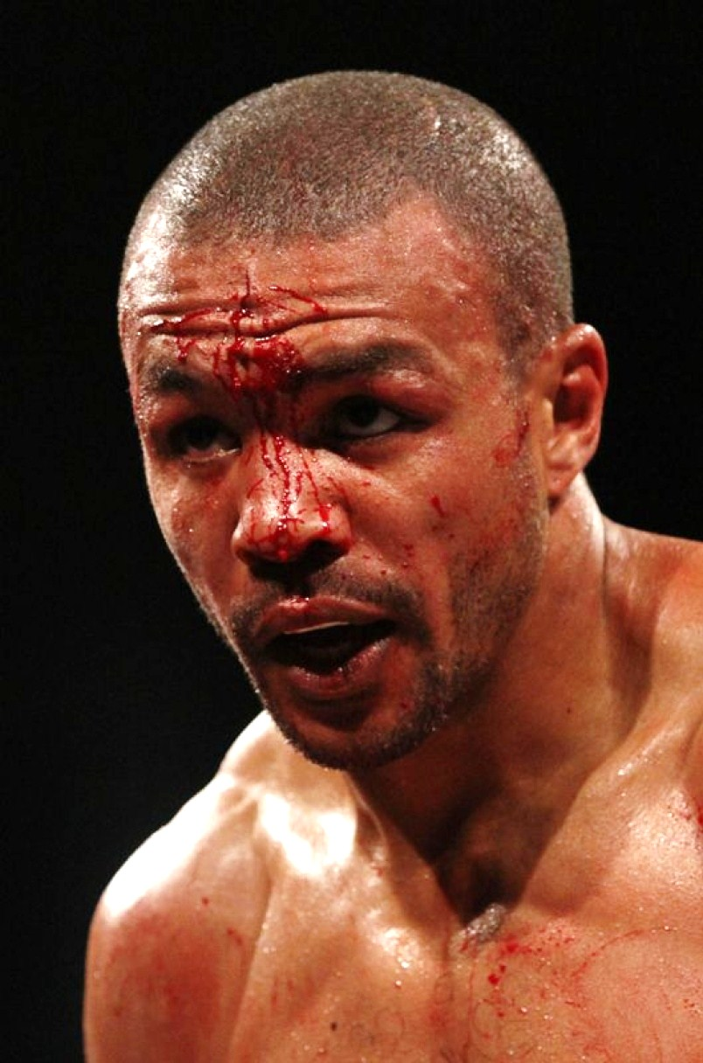

Slide 27
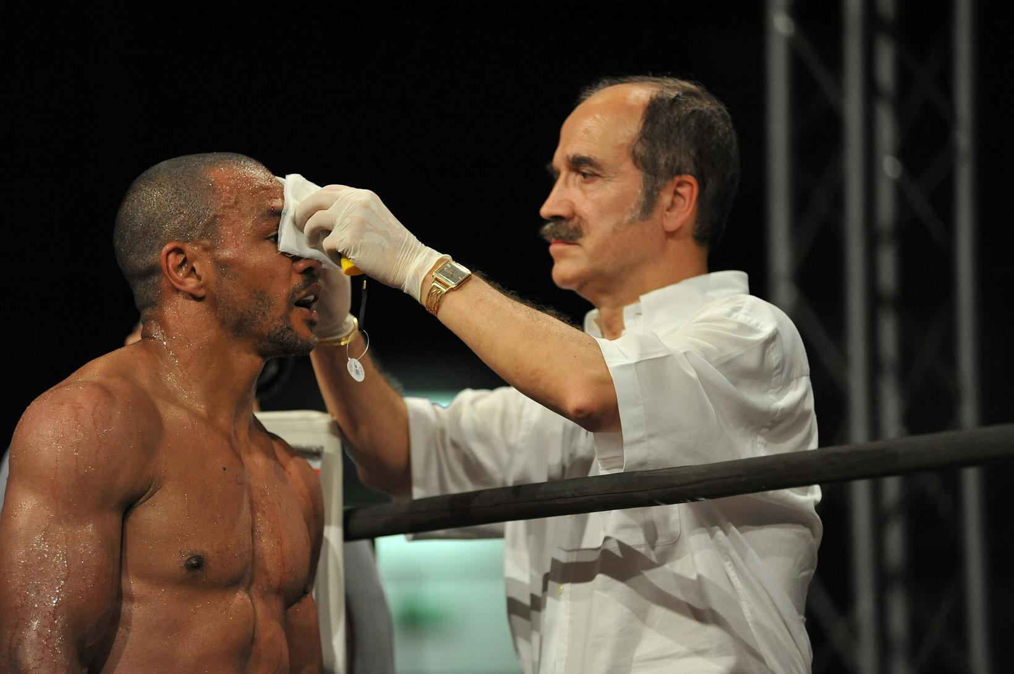

Slide 28


Slide 29
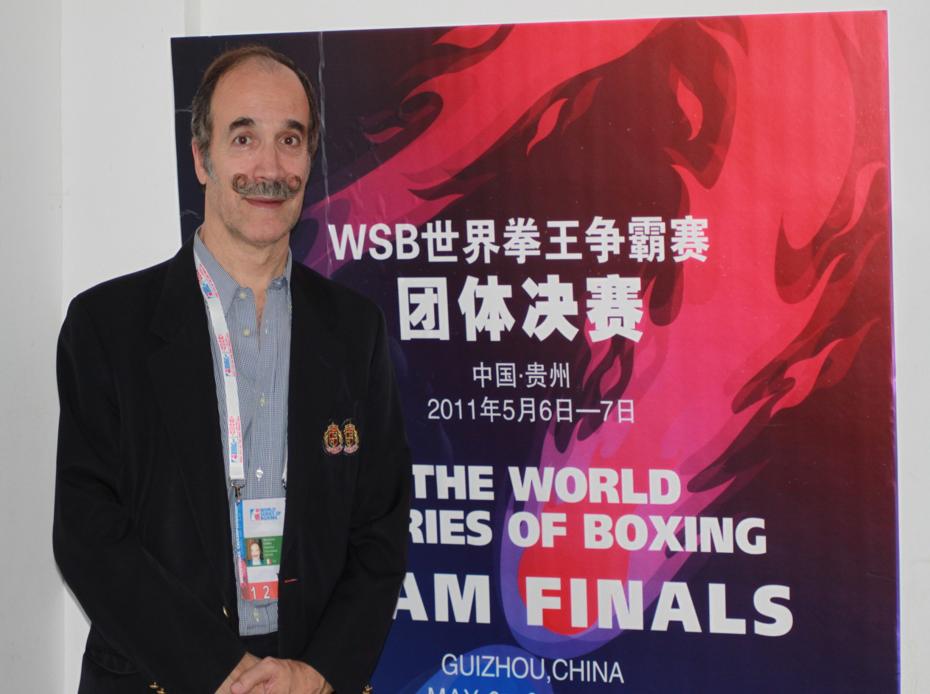

Slide 30


Slide 31
There is no doubt that a palpebral haematoma must tead to the bout being stopped. The injured boxer, deprived of an adequate field of view, will indeed be in a state of inferiority, and should he be subjected to further blows he may undergo not only eye injury but also encephalic damage.

Slide 32
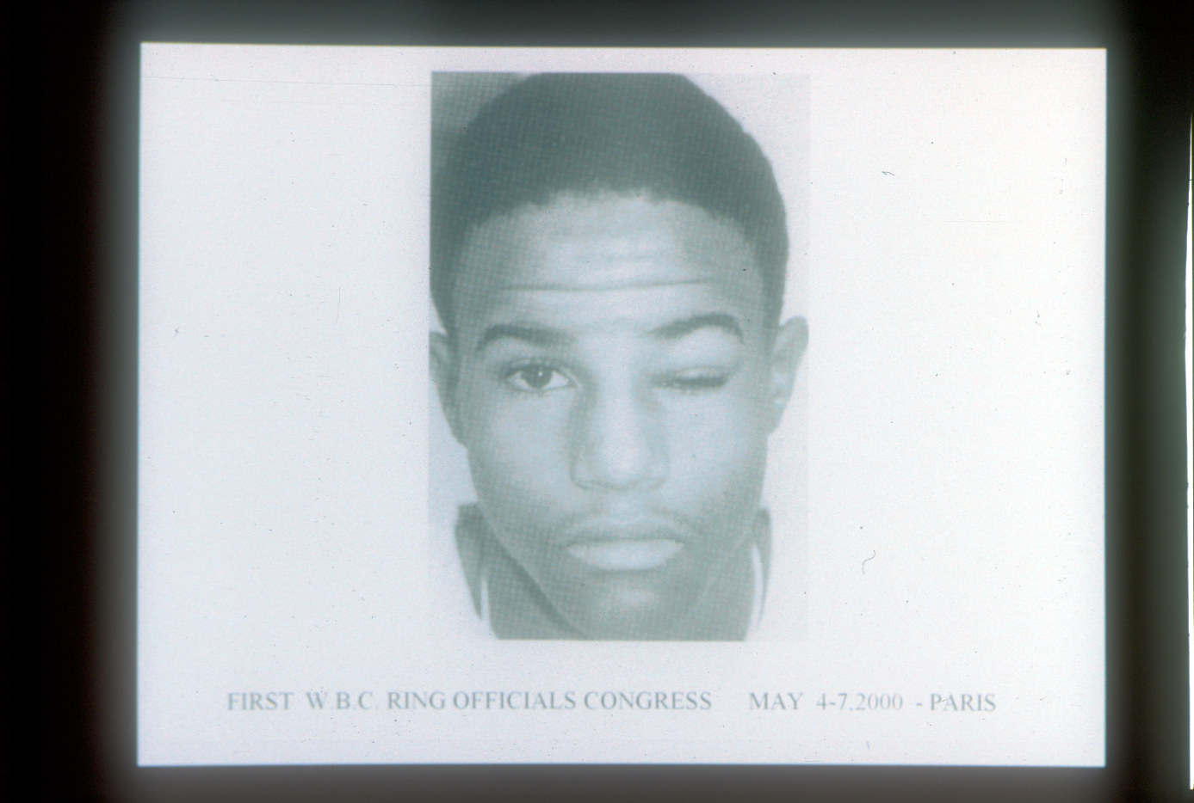

Slide 33
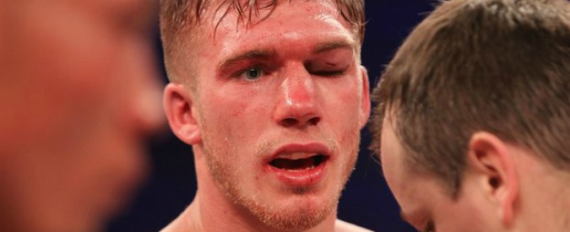

Slide 34
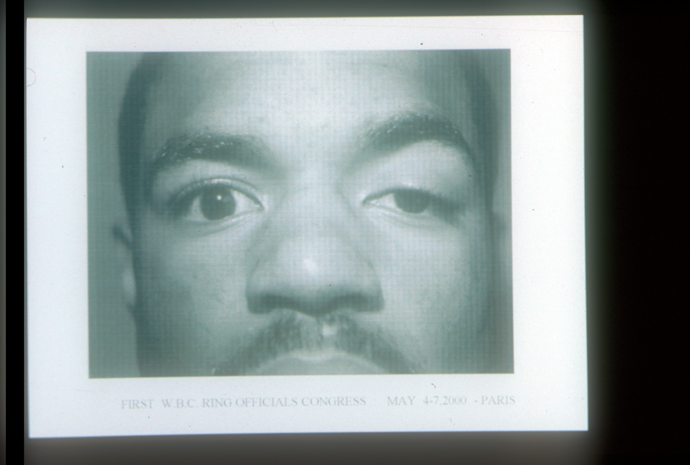

Slide 35
While CHEEKBONES are not a particularly dangerous part of the body in terms of wounds, they may become swollen and bruised, with possible haematomas also affecting the lower eyelid.
One must remember that wounds to cheekbone skin should not rule out the possibilty of bone breaks. Only comparative X-rays of the maxillary bones will be able to rule out possible skeletal lesions.

Slide 36
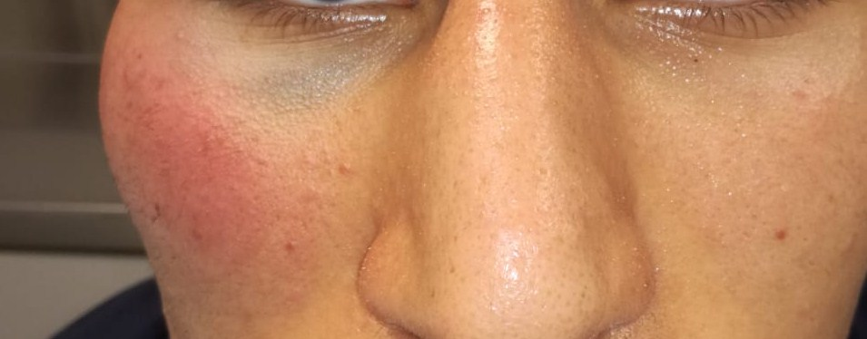

Slide 37
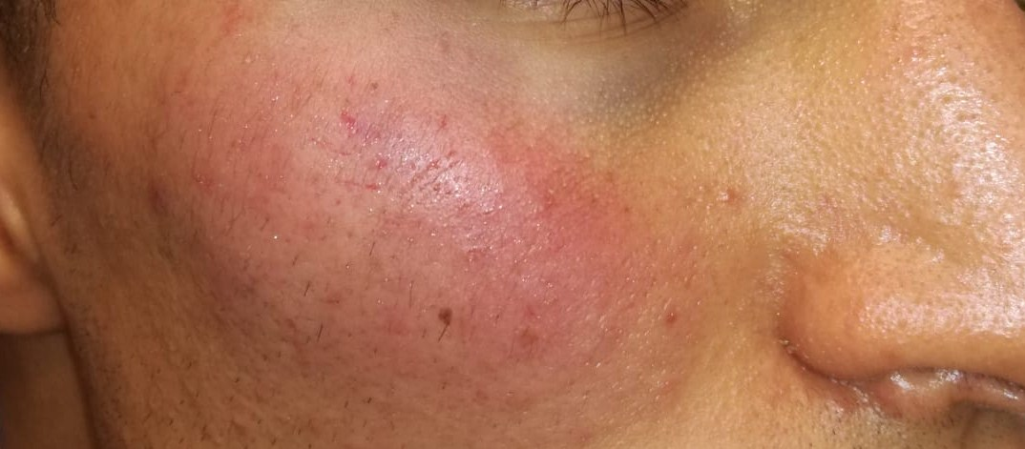

Slide 38
NOSE WOUNDS
These may affect the root of the nose and alary cartilages. Repeated blows with an angle of incidence going upwards (uppercuts) or exerting direct or lateral acceleration may cause injuries to the skin, nasal mucous and bones. The "Locus Valsavae" proves to be particularly vascularised thus anterior nosebleeds are frequent. These may affect the boxer’s breathing. This in turn may produce hypecania, which could cause cerebral hypoxia, creating a perceptive deficit that could prejudice ideational-motor capacities.

Slide 39
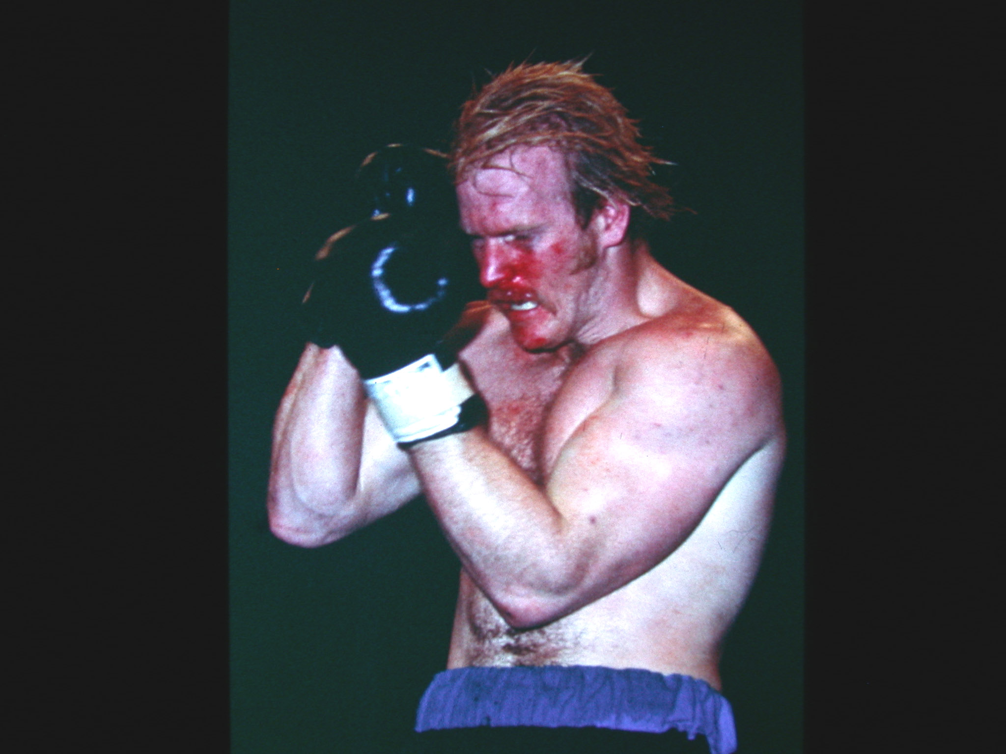

Slide 40
The Sports Medicine Specialist should carefully examine not only the boxer’s nose but also, endowed with a rhinolaryngitoscope, the oral cavity to rule out heamorrhages in that region. After the bout is stopped, therapy entails firstly an appraisal of the extent of the nosebleed, with the possible employment of inner plugging. The therapy is completed by the use of cryotherapy, anti-oedematous and/or antibiotics.

Slide 41
CHIN WOUNDS
These may affect the jawbone and dental arches, with the spitting of blood from dental avulsions. The blood gushing out with each brrath is not in itself invalidating, but it may be considered as indicative of the gravity of the jawbone injury, If serious, the bout must be stopped.

Slide 42
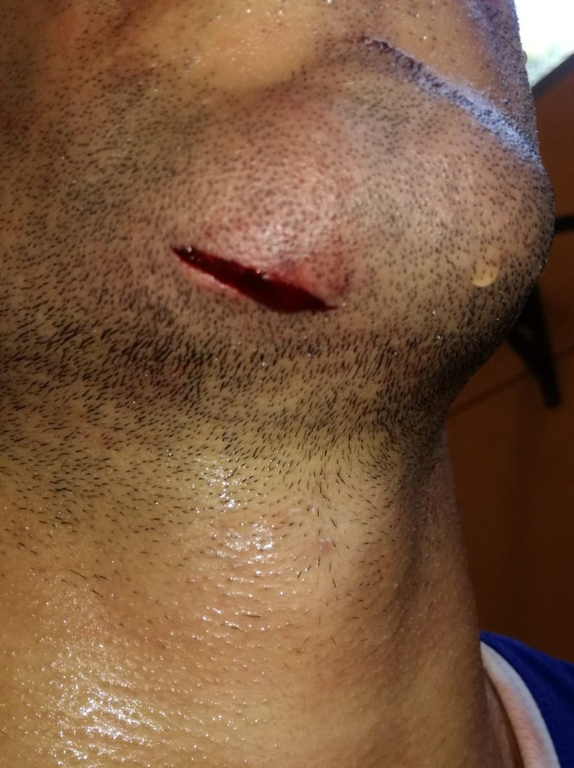

Slide 43
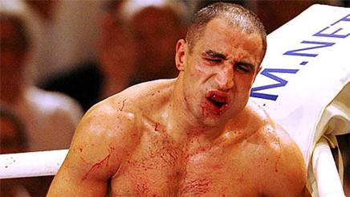

Slide 44
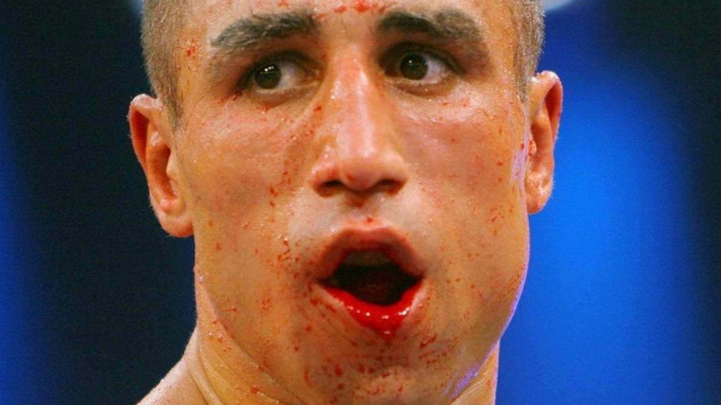

Slide 45
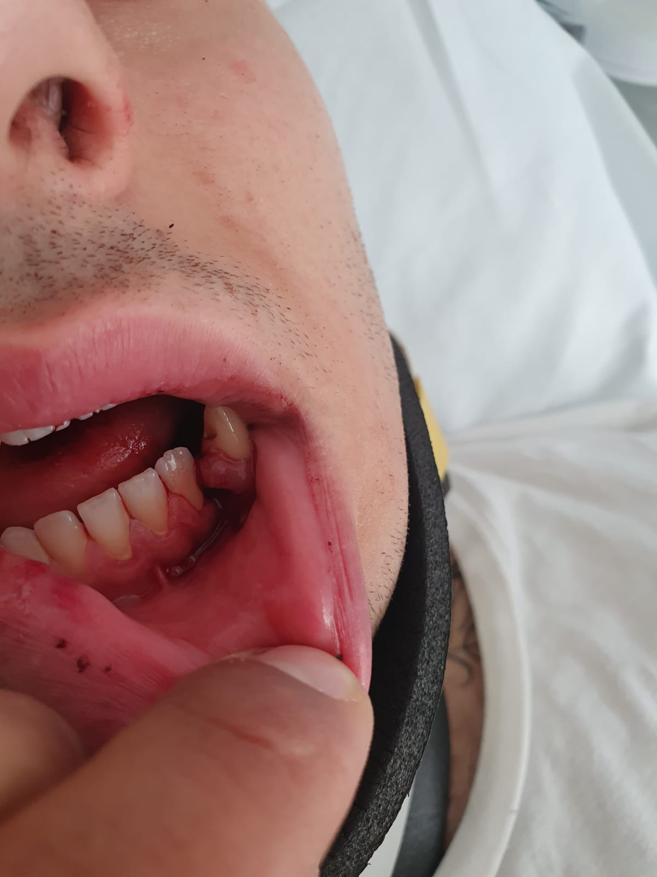

Slide 46
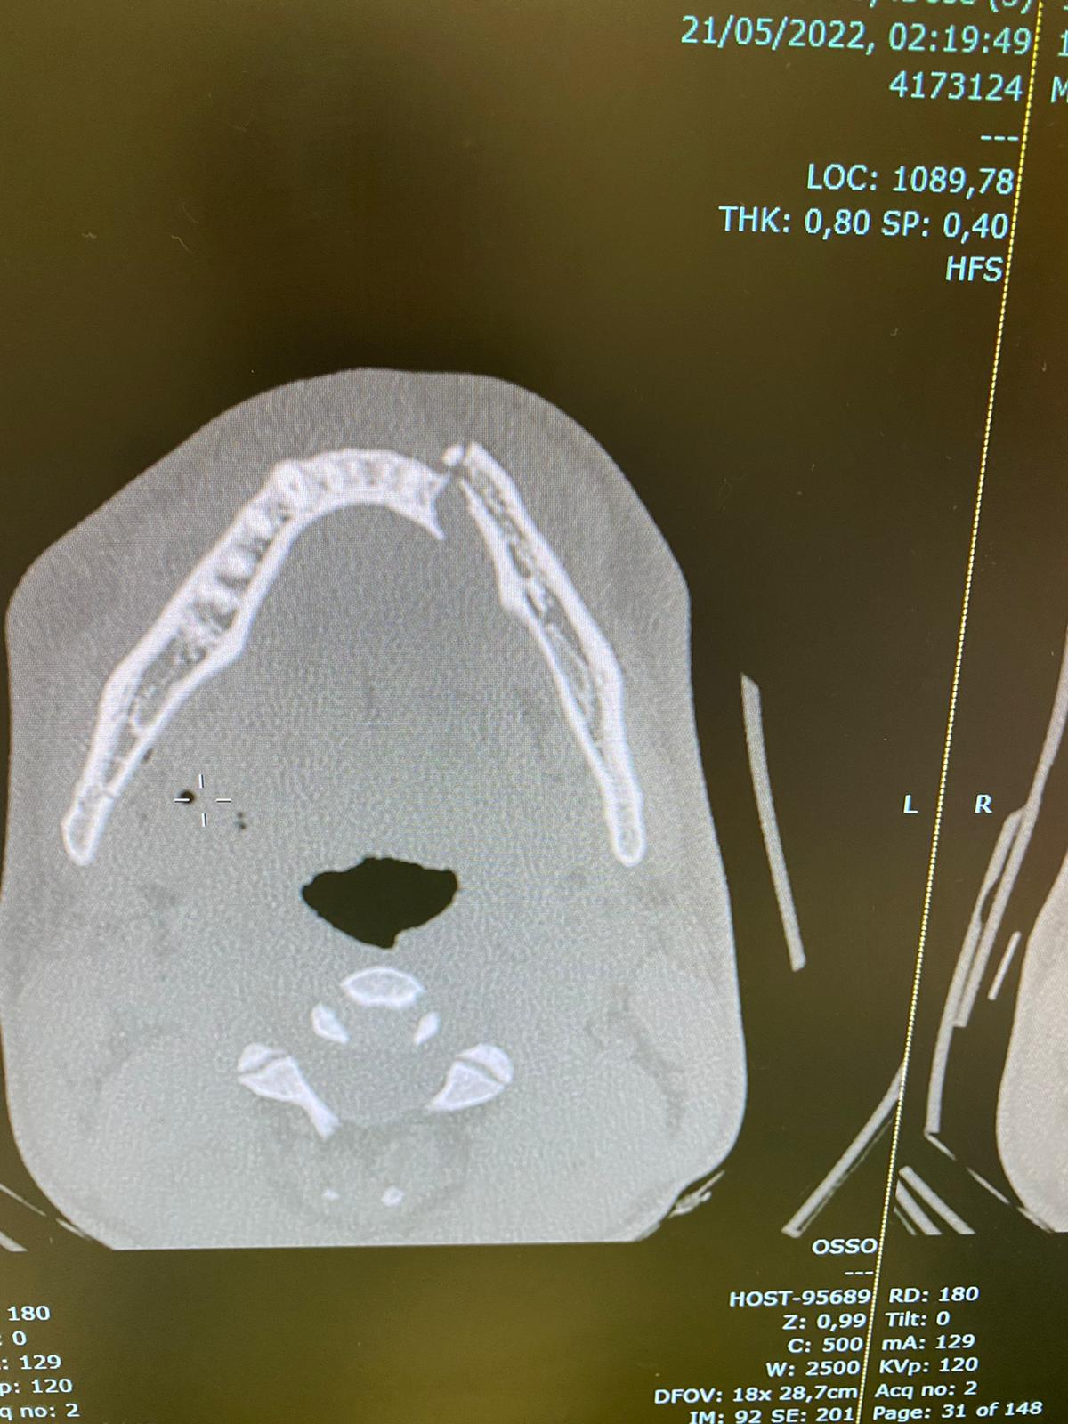

Slide 47
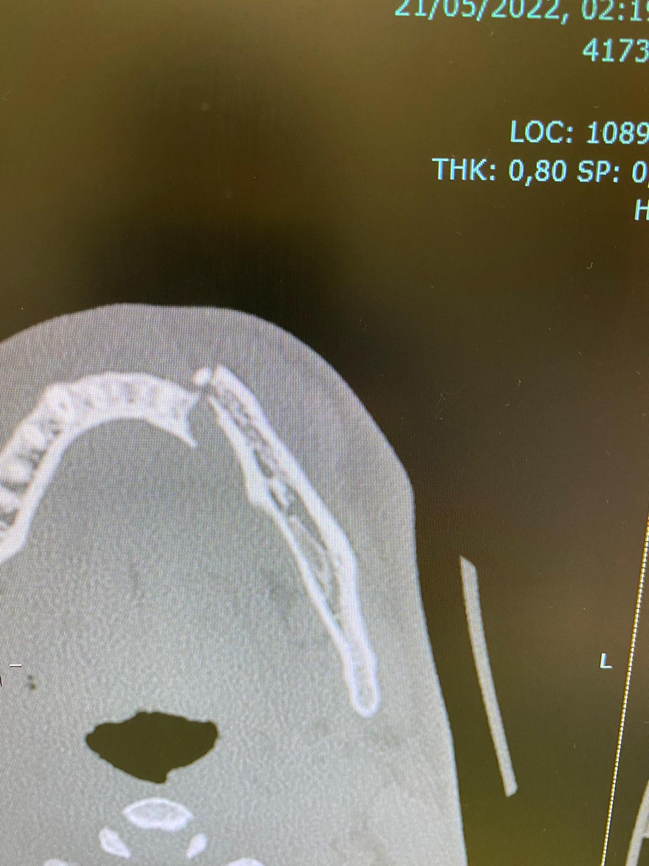
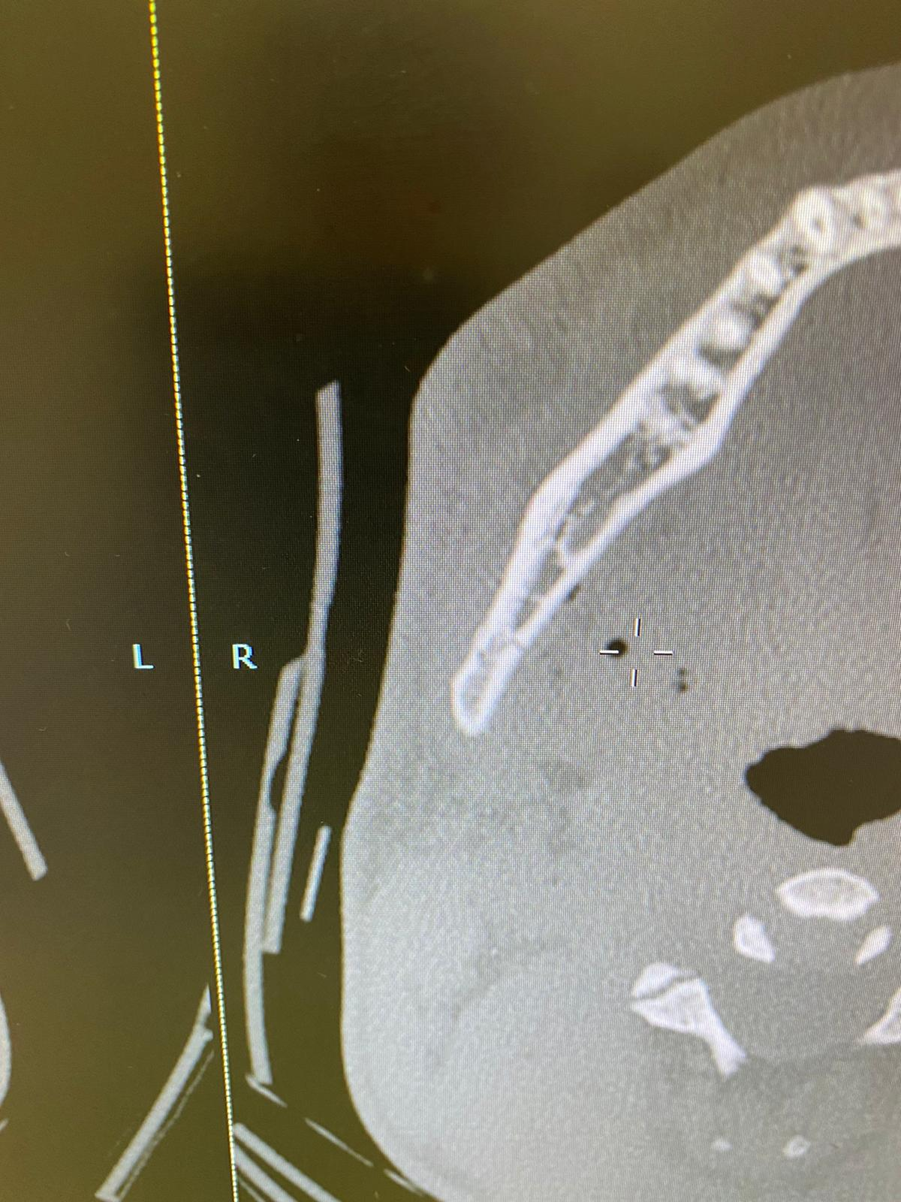

Slide 48
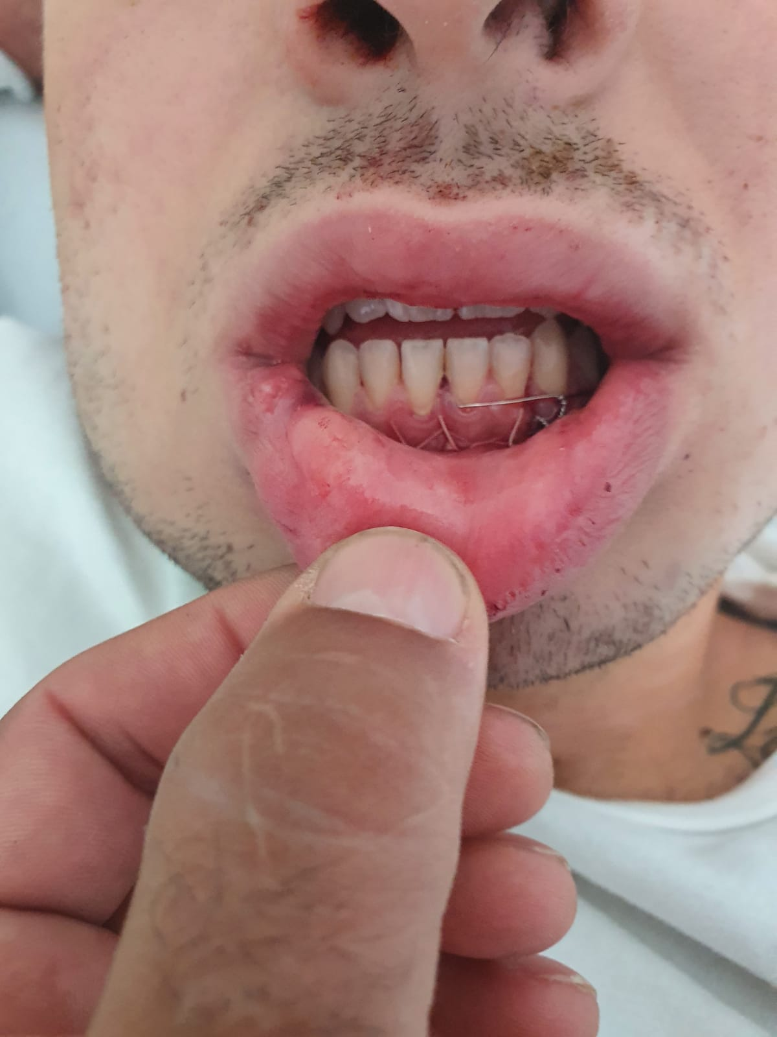

Slide 49
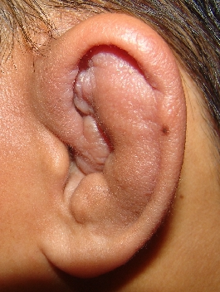
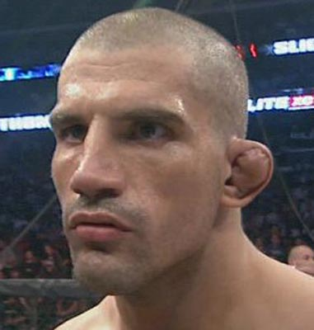
EAR WOUNDS
Lacerated and contused ear wounds and the detachment of earlobes are rare. A sliced blow may sometimes cause blood to clot between thw skin and cartilage owing to the strain of an arteriole (deriving from the posterior artery). This clot may be cleared up in a sterile setting using appropriate surgical instruments

Slide 50
Most Common Emergencies in Boxing
Closed head trauma
Facial lacerations

Slide 51
Lacerations
Location, location, location!
Length and depth
Intraoral (airway compromise)
Hematomas (Rahman-Holyfield)

Slide 52
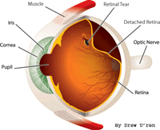
Oral/Ocular/ENT Trauma
Mandible Fractures
  potential airway obstruction
  worse if bilateral
  Importance of a good mouthpiece
Orbital Fractures
  extra-ocular muscle entrapment
  hyphema, retinal detachment
ENT Trauma
  ruptured TM vs. blood in the EAC
  nasal fractures, epistaxis
  direct laryngeal injury (acute or delayed)

Slide 53
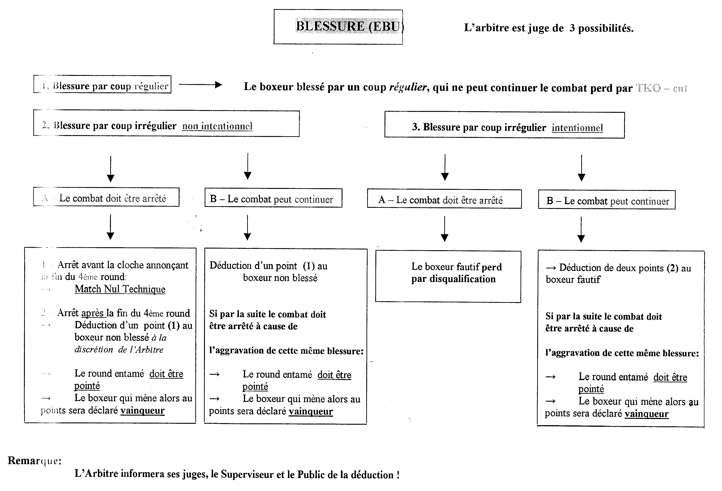

Slide 54
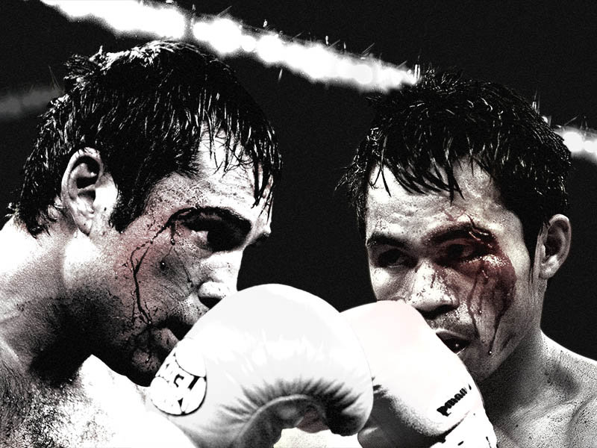

Slide 55
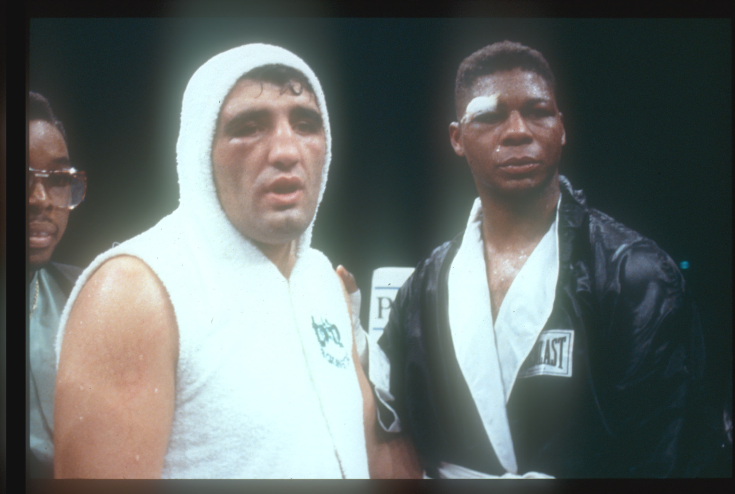

Slide 56
American Academy of Ophthalmology Statement
Boxing and full-contact martial arts pose an extremely high risk of serious and even blinding eye injury.
There is no satisfactory eye protection for boxing, although thumbless gloves may reduce the number of boxing eye injuries.

Slide 57
Mechanism of
Boxing Injuries
Coup Injuries
  Direct blow with local damage
  Outer surface of the eye is particulary venerable
  Corneal and lid injuries
  Infero-temporal blow can cause direct damage to sclera, ciliary body, and retina
  Maybe cause of angle recession and retinal breaks

Slide 58
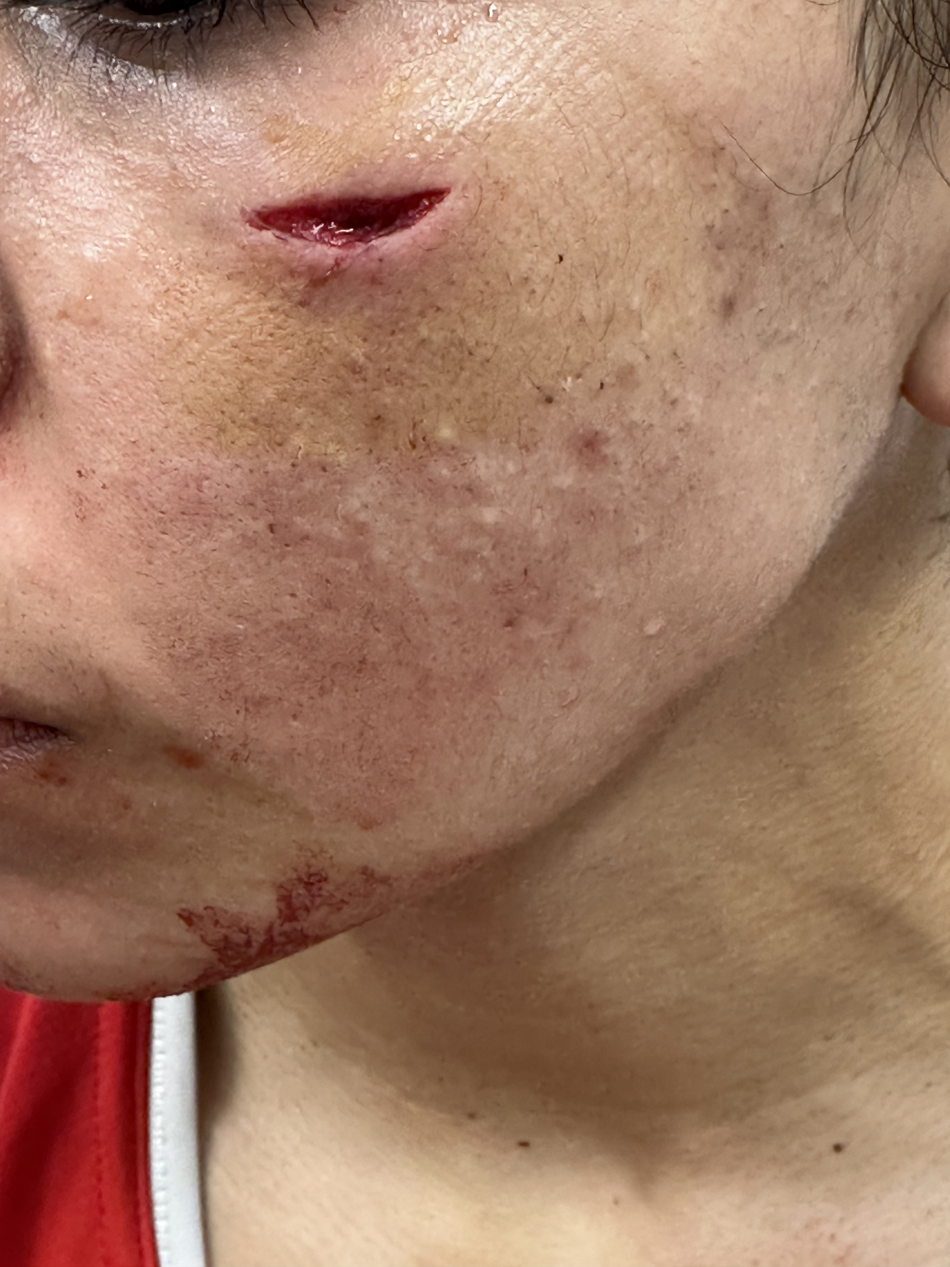

Slide 59
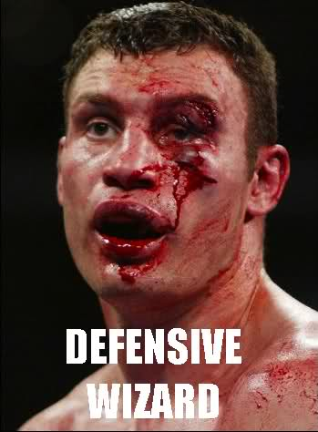

Slide 60
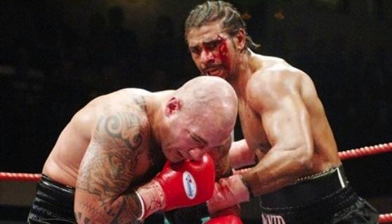

Slide 61
Mechanism of
Boxing Injuries
Contrecoup Injuries
  Remote from area of direct trauma
  Line of force traverses the globe
  Produces damage at interface of tissues or between two tissues with differing densities
  Cataracts
  Traumatic Maculopathy
  Macular Holes

Slide 62
Mechanism of
Boxing Injuries
Expansion of Equatorial Region
  Globe compressed anteriorally/posteriorally
  Circumferance of equator increases
  Attachment of vitreous to the peripheral
  retina is disturbed leading to both
    Retinal Tears
    Retinal Detachments

Slide 63
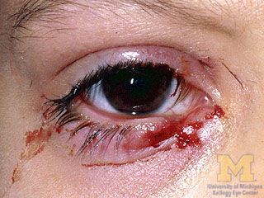
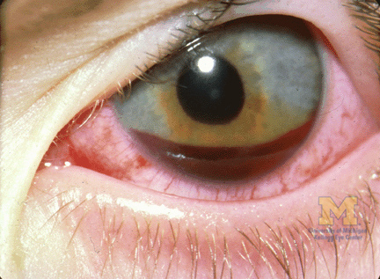
Boxing Injuries
Concussional Injuries
Lids
Lacerations
Bruising
Abrasions
Corneal
Conjunctival
Anterior Chamber
Hyphema
Traumatic Mydriasis
Angle Recession

Slide 64
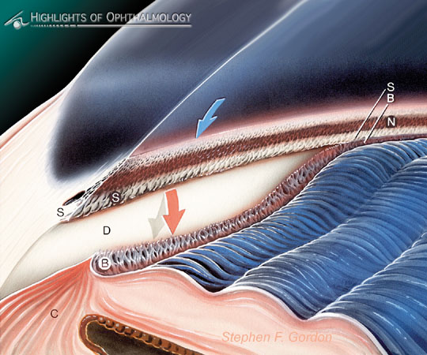
Angle Recession –
A Secondary Glaucoma
A contusion type injury can lead to angle recession glaucoma.
This is the result of significant damage to the anterior chamber angle
In less severe injuries the fibers of the ciliary body are split apart.
When trauma is extensive it may result in different degrees of dislocation of the ciliary body from the scleral spur leading to fibrosis of the trabecular meshwork
Gonioscopically the ciliary body band, which is normally attached to the scleral spur, is torn from the scleral spur and a band of white sclera is visible between the ciliary body and the scleral spur

Slide 65
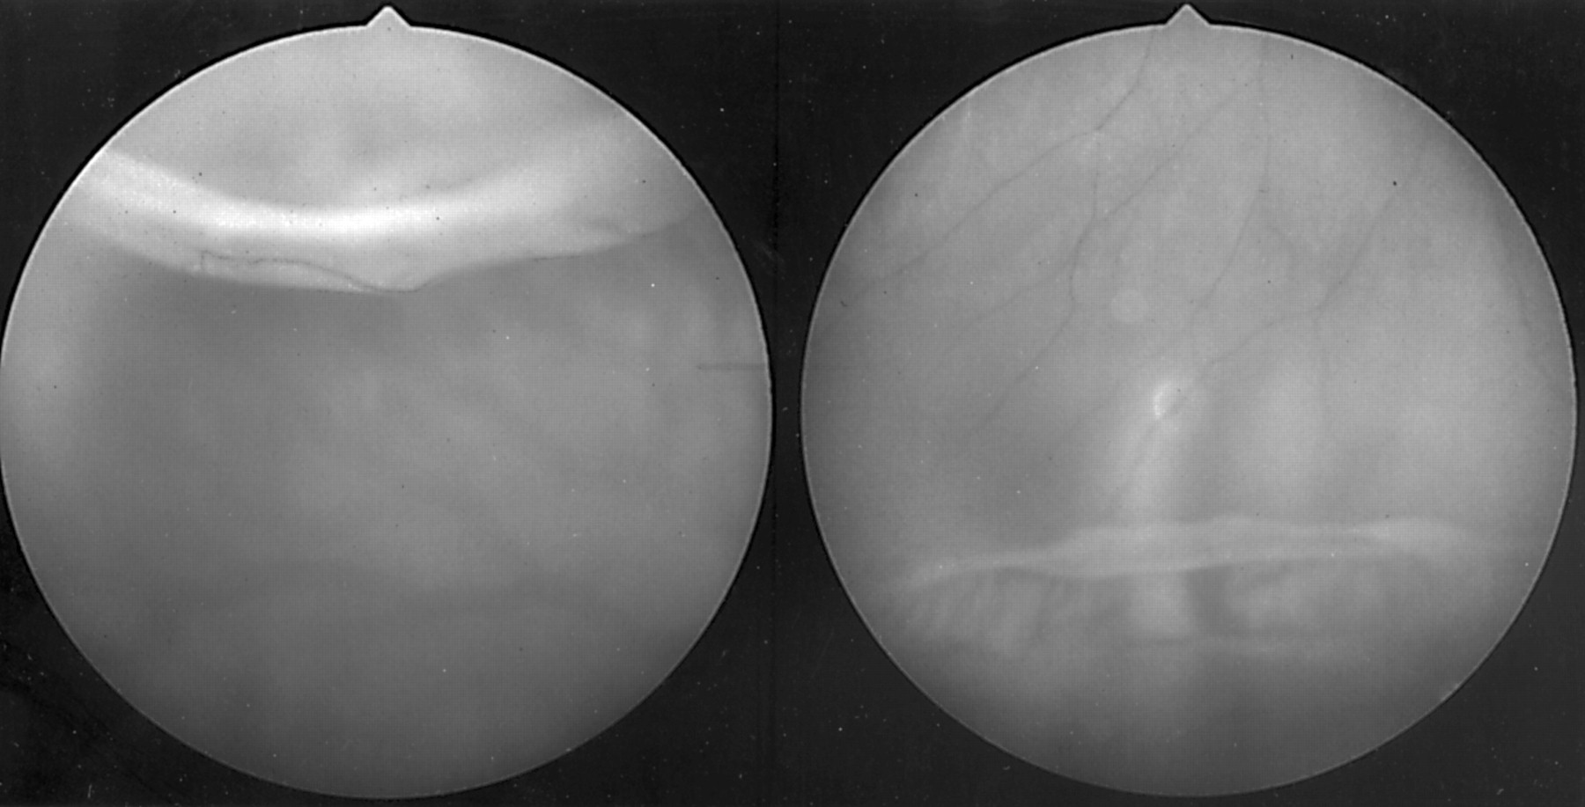
Giant Retinal Tear and Detachment
Fundus photographs of the right peripheral retina showing the superior (left) and inferior (right) giant retinal tears. Note the superior retinal flap folding posteriorly and the elevated anterior flap of the inferior tear.

Slide 66
Ocular Complications of Boxing
66% had at least one ocular injury
58% had vision threatening injuries, i.e., significant damage to the angle, lens, macula or peripheral retina
19% drainage angle abnormalities
19% had pathological cataracts
Cataracts possibly associated with anabolic steroids
24% had retinal tears

Slide 67
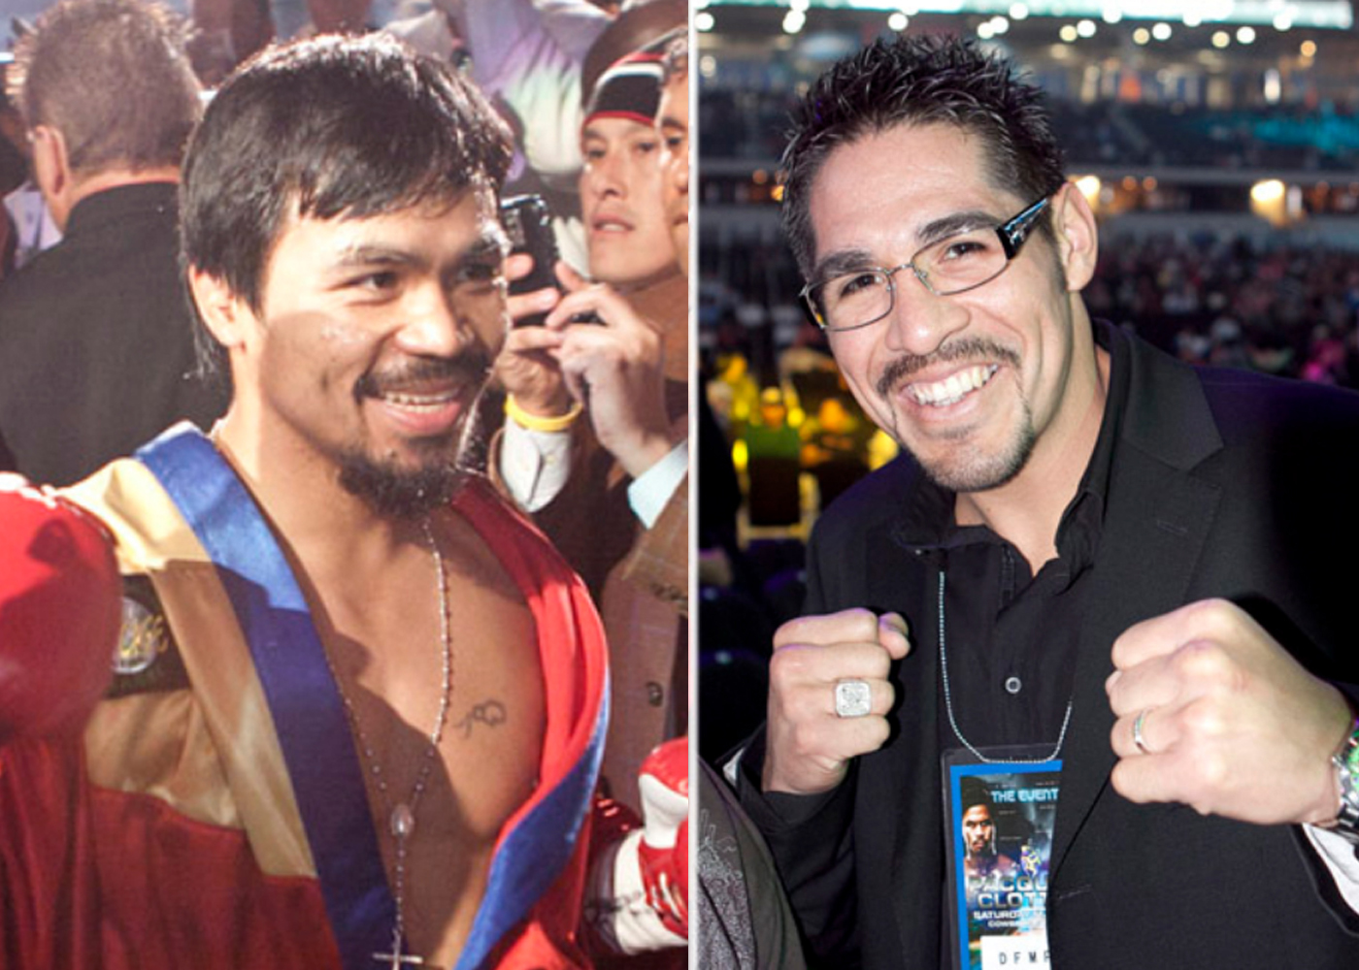

Slide 68
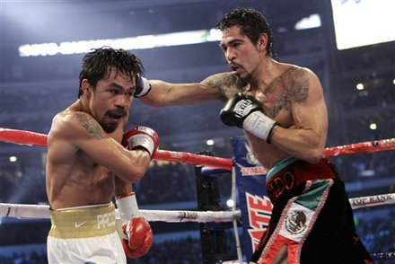

Slide 69
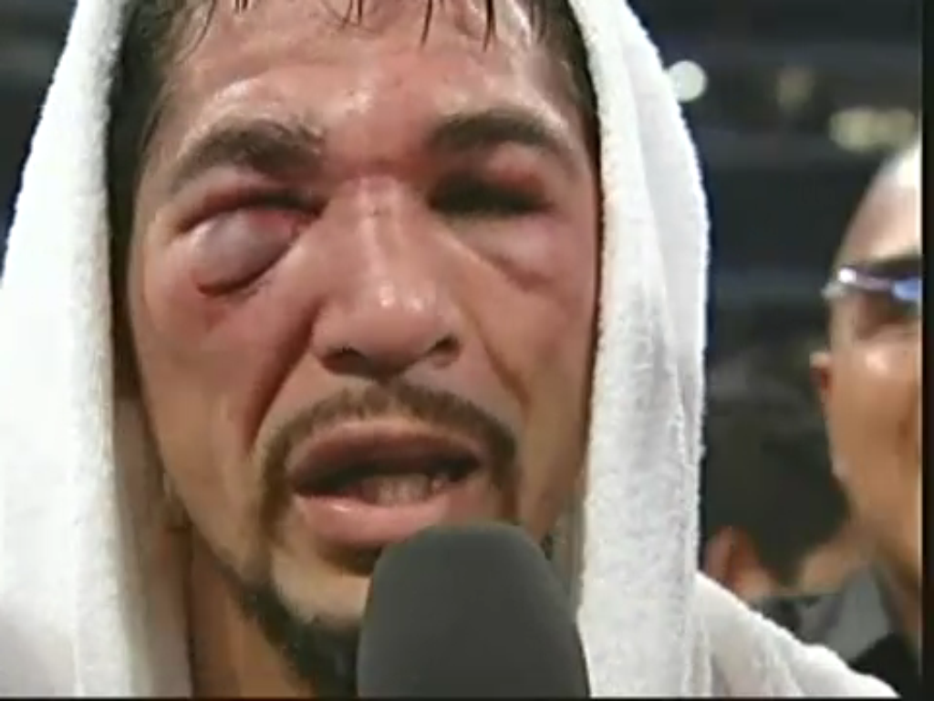

Slide 70
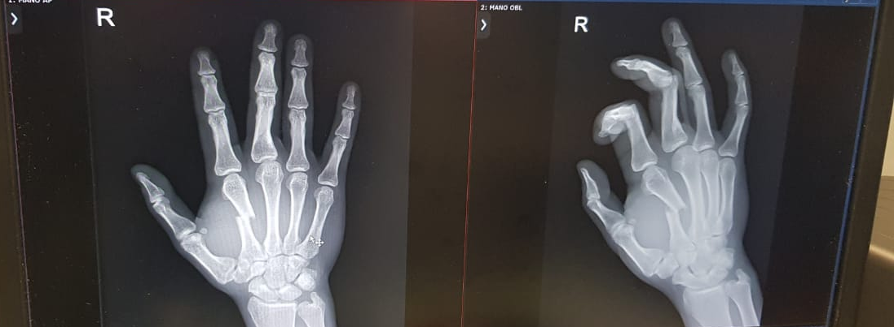

Slide 71
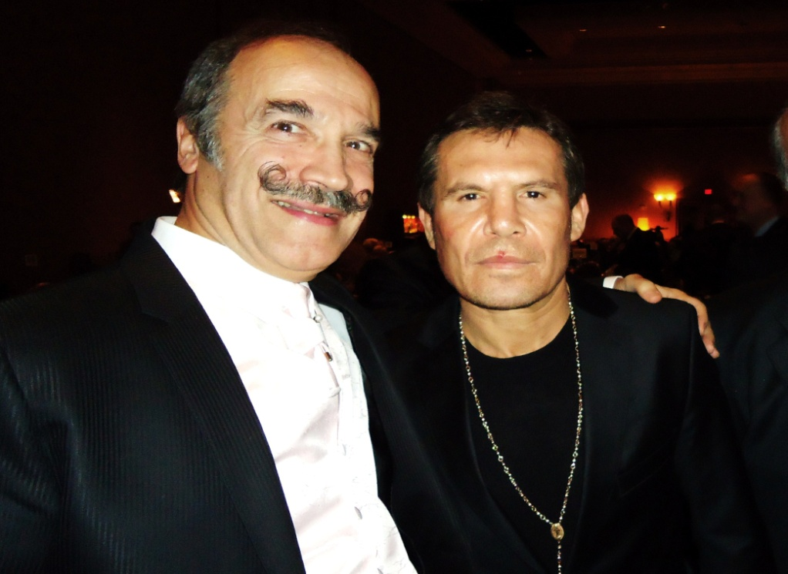
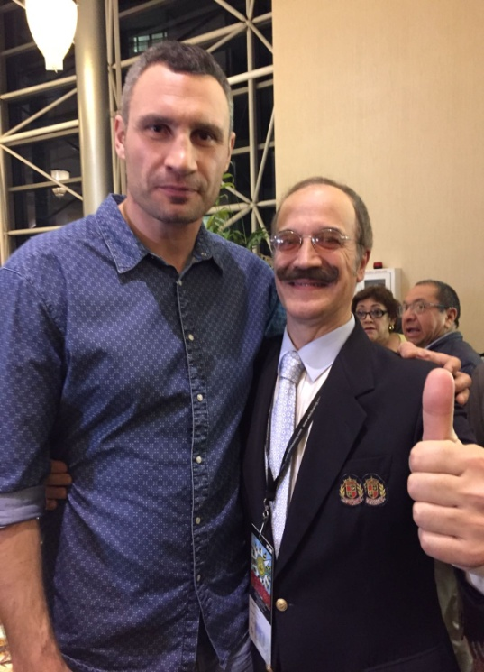
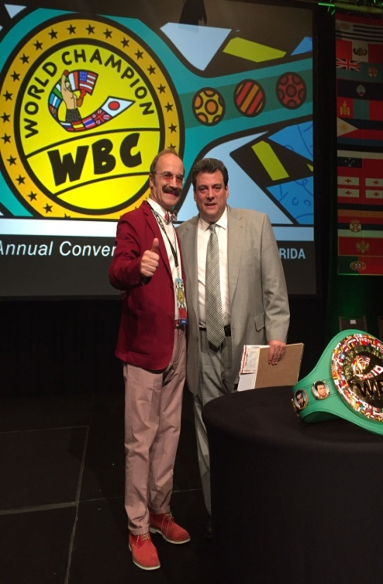



Slide 72

Meravigliarsi di tutto è il primo passo della ragione verso la scoperta.
Louis Pasteur

