Slide 1

LA CONCUSSIONE CEREBRALE
CONOSCERLA PER PREVENIRLA, RICONOSCERLA PER EVITARE COMPLICANZE

Slide 2
Prof. Dott. Mario Ireneo Sturla
Presidente AMSD Pavia FMSI
Coordinatore Sanitario Nazionale FPI
Presidente Sezione Studi e Ricerche FPI
Presidente Commissione Medica Europea EBU
Co-chairman Medical Commission WBC

Slide 3
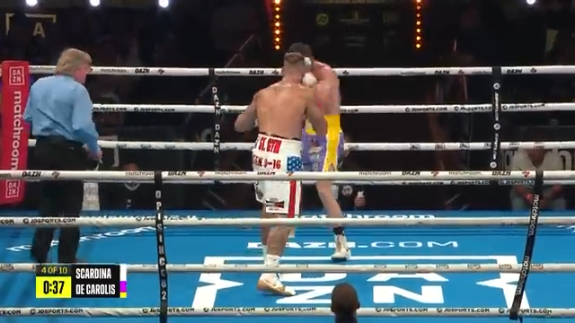

Slide 4
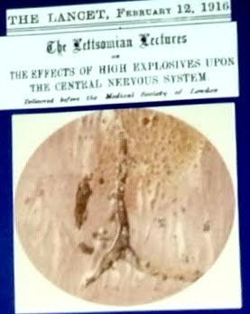
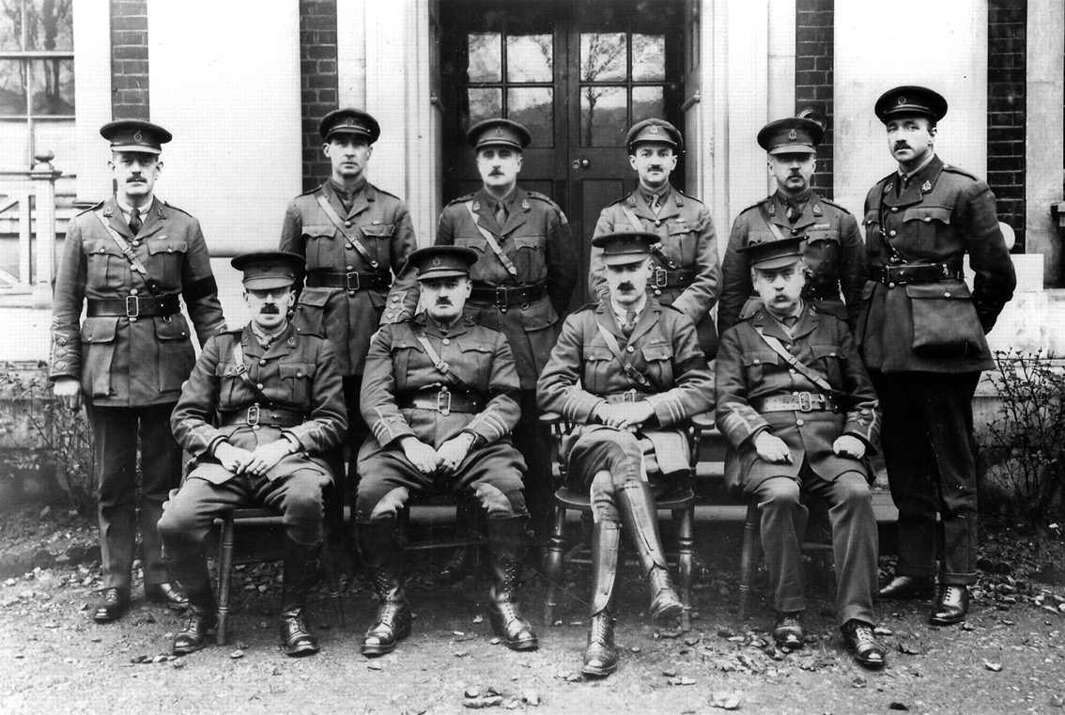
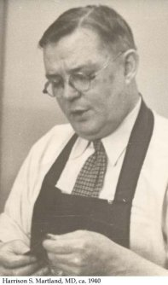
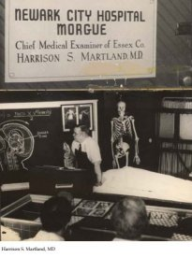
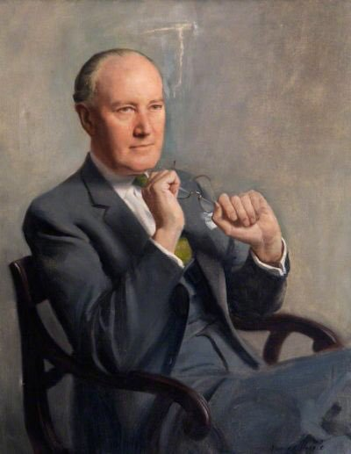
Commotio Cerebri - Sir Frederick Mott, M.D.
Punch Drunk - Harrison Stanford Martland, M.D.
CTE – Critchley, 1949
KING’S COLLEGE
HOSPITAL
Research - UCLA

Slide 5
INTRODUCTION
As brain injuries are becoming increasingly common in athletes, not only in boxing, early detection and management of brain injuries in sports are of utmost importance in preventing chronic neurological and psychiatric decline.
New neuroimaging techniques and biomarkers have been recently applied and detected in order to improve precocity in diagnosis and prevention of long lasting effects.

Slide 6
Epidemiology
of Head Injury, Overview
Concussion
Mild Head Injury
Moderate Head Injury
Severe Head Injury
Cost
$48.3 Billion/yr
$16.3 Billion/yr
Medical consults 2,000,000
Hospitalized 375,000
Deaths 75,000

Slide 7
Outline
Clinical Pathophysiology
Cerebral Metabolism
Cerebral Blood Flow
Metabolism and Blood Flow Dysfunction
Alternative Fuels

Slide 8
Traumatic impacts to any
area of the head will
deliver a component of
force to the jaw joint

Slide 9
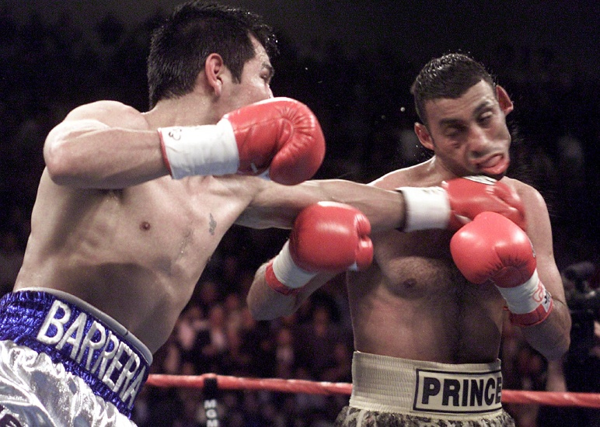

Slide 10
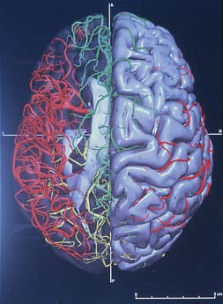
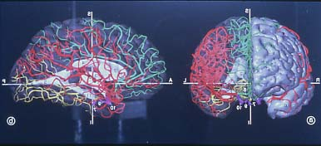
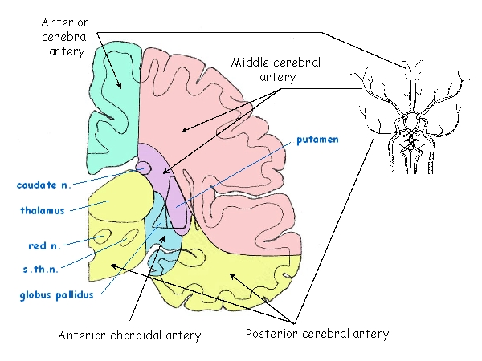
Perfusion Territories
Habgood

Slide 11
Cerebral Forces Causing Injury
Compressive/Direct Pressure
Tensile/Negative Pressure
Rotational/Shearing Forces
  Cause of most devastating injuries

Slide 12
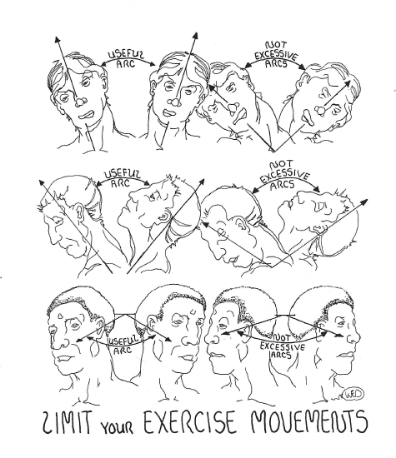

Slide 13
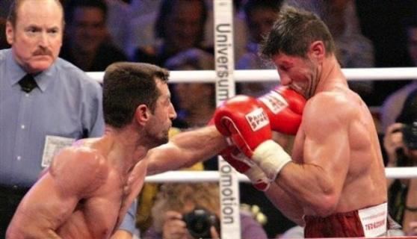

Slide 14
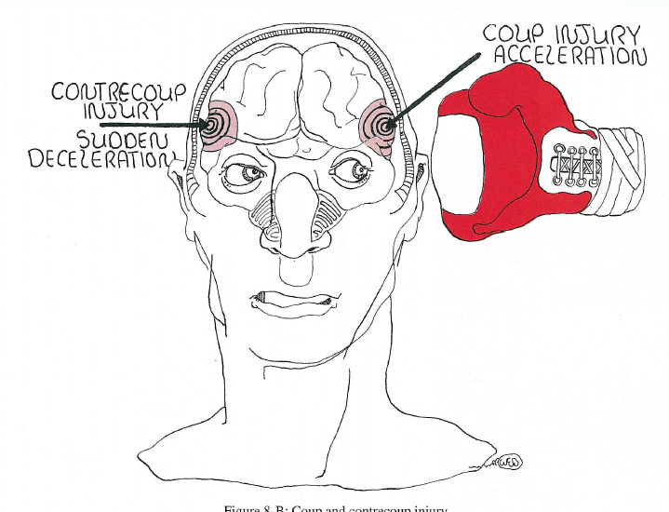

Slide 15
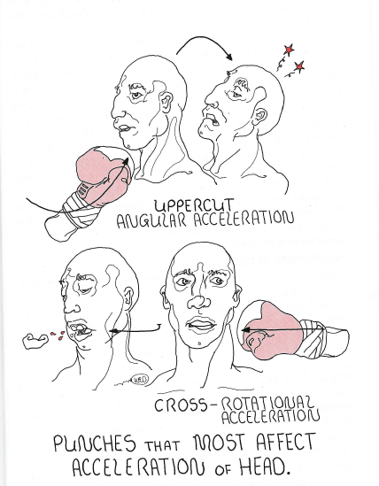

Slide 16
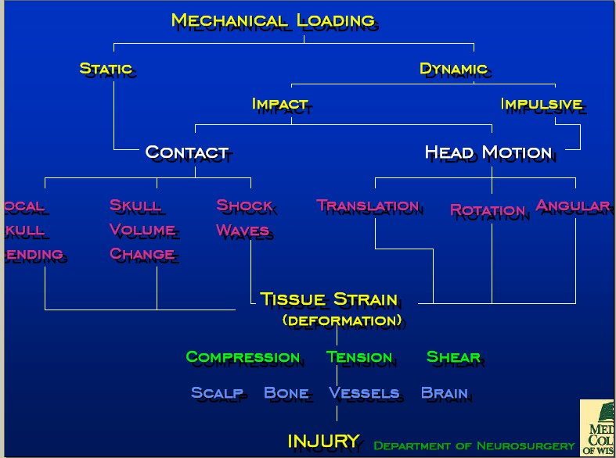

Slide 17
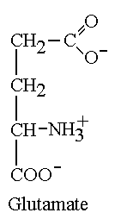
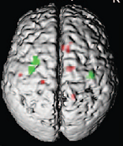
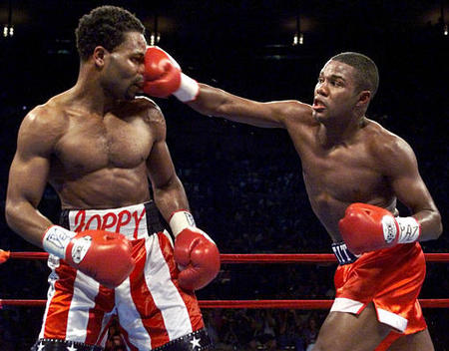
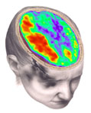
THE TRANSLATIONAL SCIENCE
OF CONCUSSION
Molecules, Imaging and Cognition
UCLA Brain Injury Research Center
Divisions of Pediatric Neurology and Neurosurgery

Slide 18
T.B.I.’s Acute Pathophysiology
ATP Need
K⁺
glut
Ca++
glut
glut
Mitochondria
ATP Loss

Slide 19
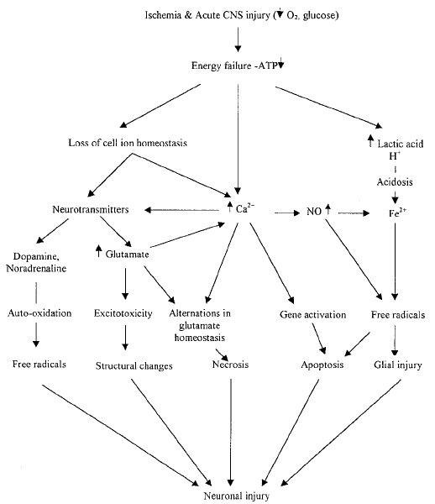
Injury Cascade
Gilgun-Sherki et al., 2002

Slide 20
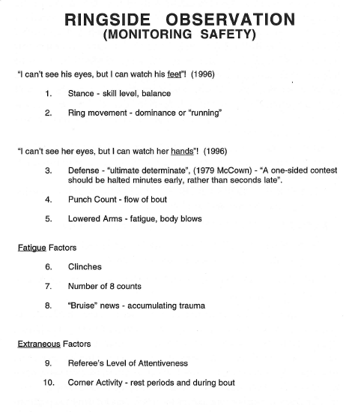

Slide 21
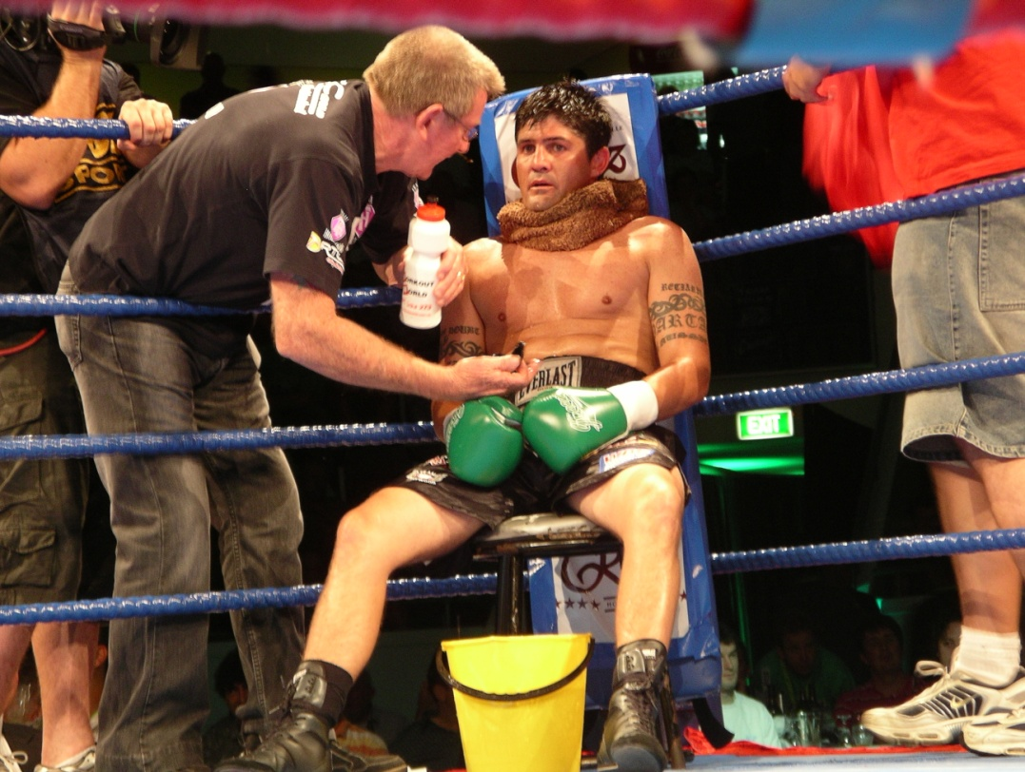
INCIDENCE OF CONCUSSION IN PROFESSIONAL BOXING
Based on ringside report forms
Overestimated?
Underestimated?
Notes:
Concussion incidence figures are often based on retrospective studies, of ringside incident forms.
It is possible the incidence of concussion in boxing is over estimated The definition of concussion in report forms is usually a KO or TKO. However as you are well aware, these do not necessarily result in concussion.
Concussion in boxing might also be underestimated. It is possible that boxers, with subtle symptoms are able to complete a bout and are not bought to the attention of the ringside Dr. Anecdotal reports suggest that athletes are capable of continuing complex motor activities when they are concussed; or finish a game and have no memory of this.
To date there has been no prospective work to determine the incidence of concussion in boxing or whether concussions go unrecognised.

Slide 22
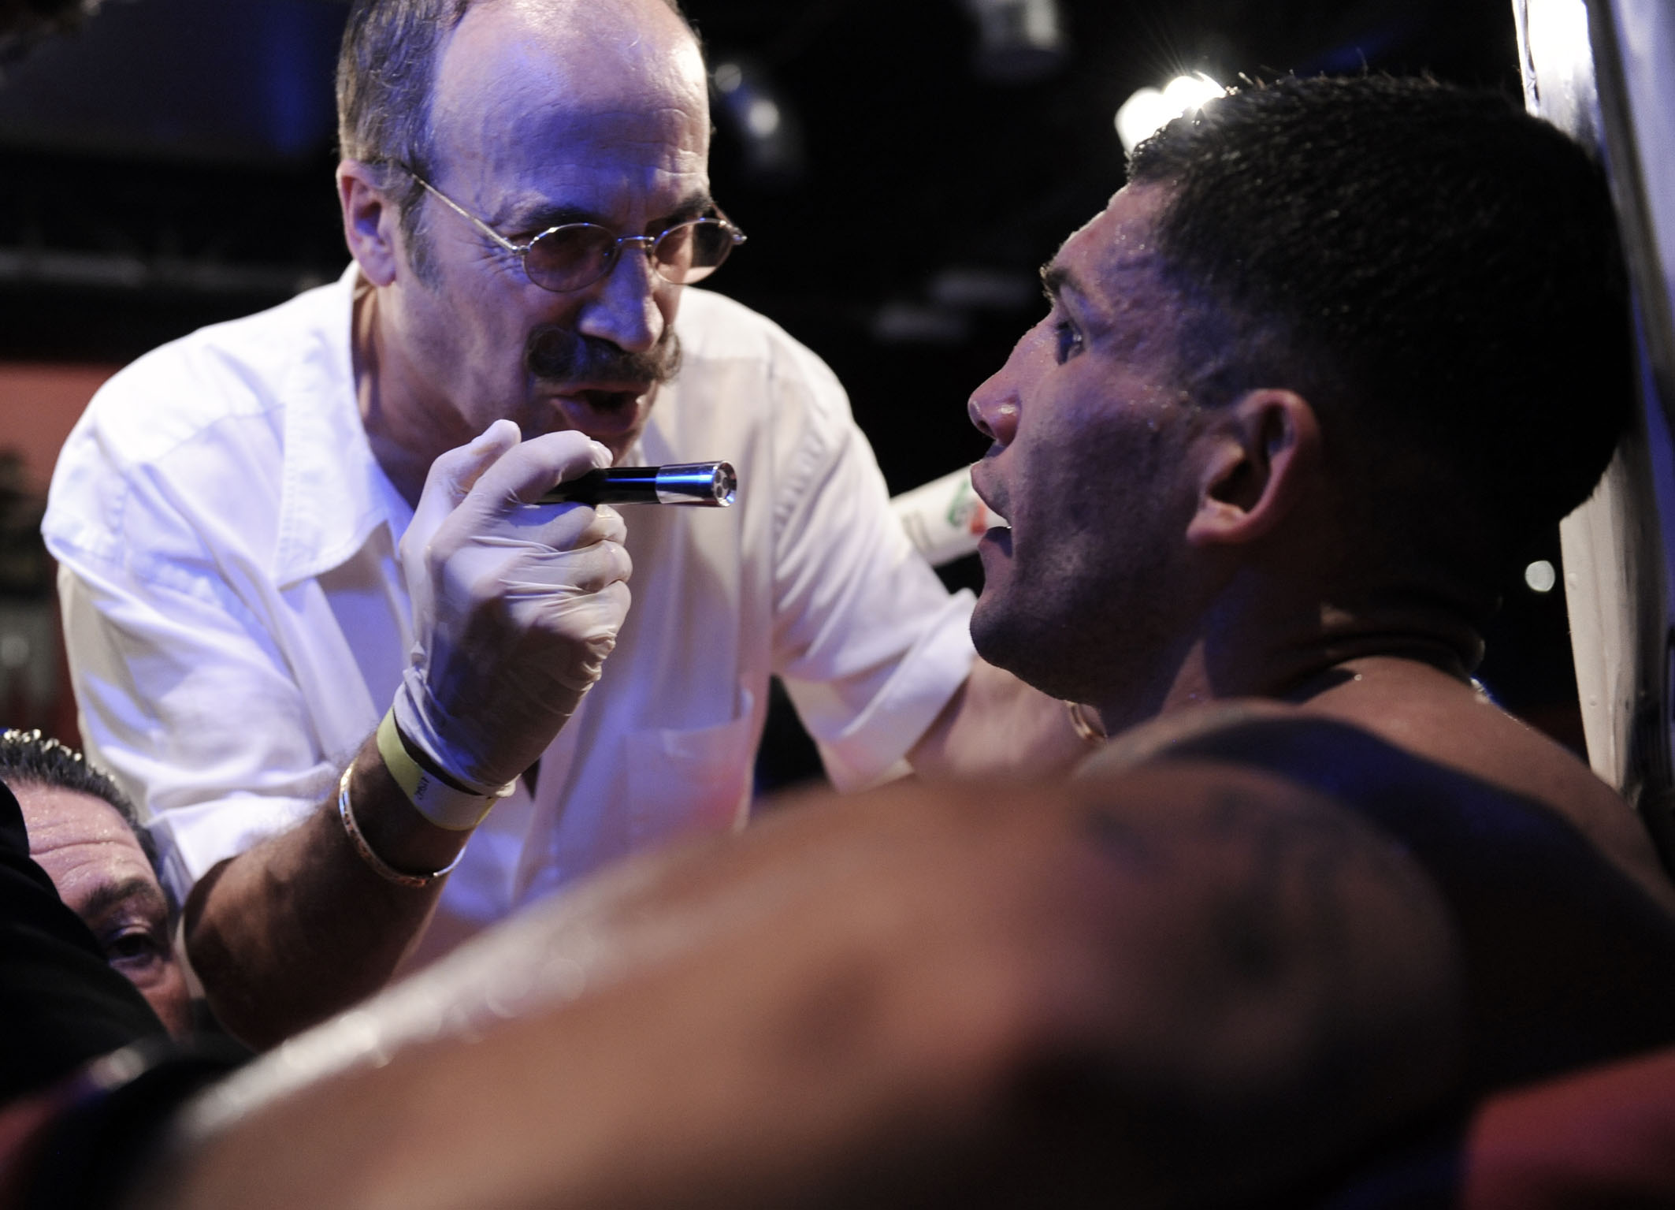

Slide 23
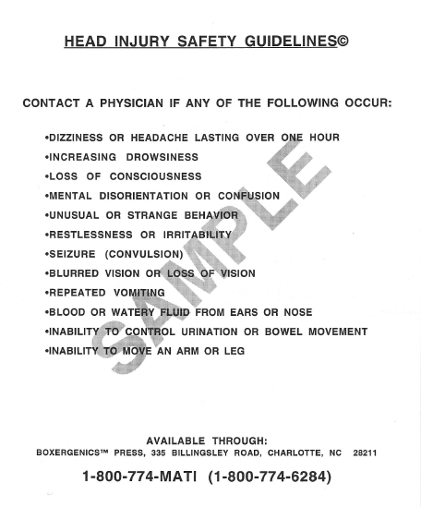

Slide 24
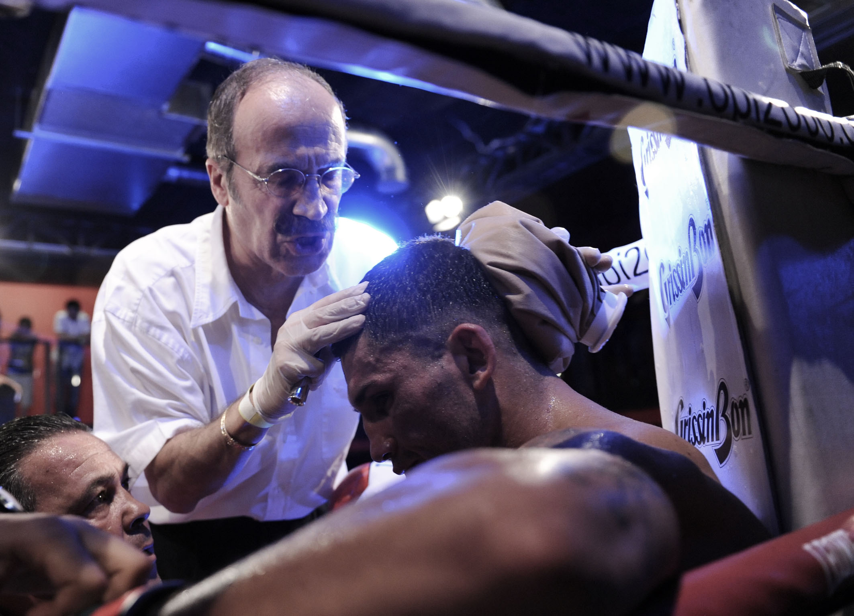

Slide 25
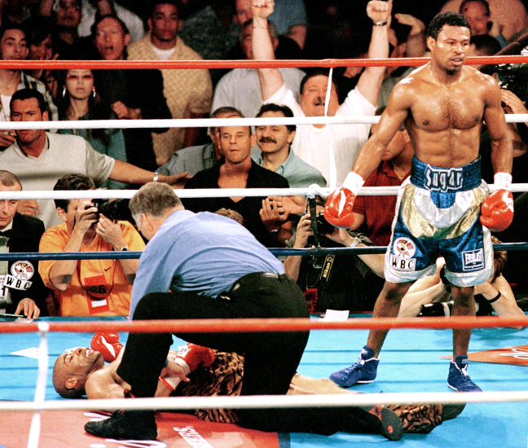

Slide 26
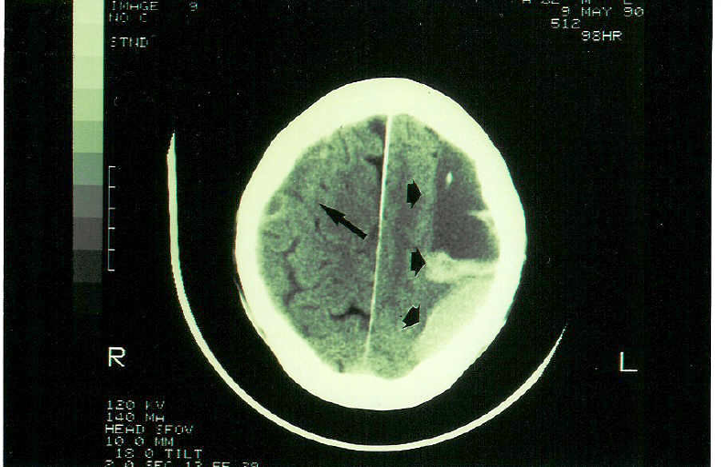

Slide 27
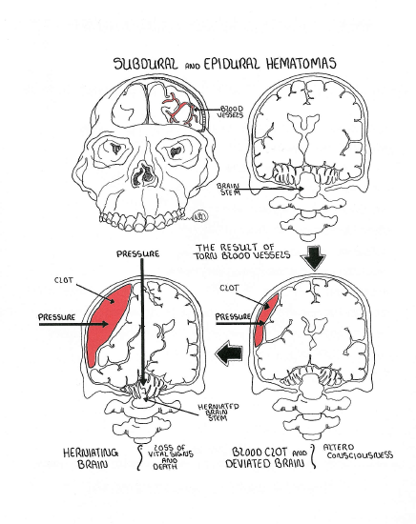

Slide 28
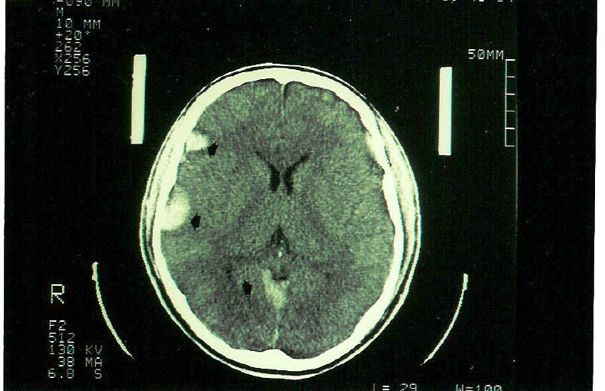

Slide 29
SPORTS CONCUSSION INCIDENCE:
Horse racing (flat) 2.5 per 100 falls
(jump) 7.1 per 100 falls
(fall/ride ratio: 16)
American football 0.2 per 1000 hours
Aussie Football 4.1 per 1000 hours
Professional boxing concussion incidence:
New York data: 80 per 1000 bouts
Jordan and Campbell, 1988
Australian data: 39 per 1000 bouts
Zazryn at al., 2003
Notes:
The reported incidence of concussion varies in different collision sports. Here are just a few examples
Horse racing has the highest incidence of concussion in all professional sports.
(But based on the falls/ ride ratio, it appears that flat jockeys have an incidence rate of about 49 concussions per 1000 hours of racing. This is much higher in jump races in some parts of the world)
Aussie rules football is guilty of the highest rate of concussion in team sports with 4.1 per 1000 player hours. This high number is the result of very high velocity impact without headgear.
Professional boxing is thought to have the second highest incidence of concussion in the individual sports.
Concussion figures in boxing however, are likely to be even more unreliable than those of other sports.

Slide 30


Slide 31
EMATOMI ACUTI INTRACEREBRALI O SUBDURALI
DETERIORAMENTO NEUROLOGICO ROSTRO CAUDALE
COMA PROFONDO
IPERTENSIONE SISTEMICA E LIQUORALE
MIDRIASI FISSA , ASSENZA DI RIFLESSO FOTOMOTORE
EMIPLEGIA SPASTICA IPERRIFLESSICA
RIGIDITA' DECORTICATA E DECEREBRATA

Slide 32
EMATOMA EPIDURALE
DI SOLITO DA ROTTURA DELL'ARTERIA TEMPORALE (rima di frattura temporale)
COMPARSA DEI SINTOMI ENTRO 3 GIORNI
CEFALEA INGRAVESCENTE
DISFUNZIONI MOTORIE
DISTURBI STATO DI COSCIENZA

Slide 33
EDEMA CEREBRALE
COMPLICANZA NEI TRAUMI CRANICI DI MEDIA E GRAVE ENTITA'
PORTA AD ARRESTO RESPIRATORIO E CARDIACO
POSSIBILE COMPARSA DI CRISI EPILETTICHE
USARE DIURETICI OSMOTICI (cateterizzare il paziente)
MONITORAGGIO NEUROLOGICO CON
Glasgow Coma Scale ogni 5 minuti

Slide 34
APERTURA DEGLI OCCHI
  SPONTANEA 4
  A COMANDO 3
  DOPO STIMOLO DOLOROSO 2
  ASSENTE 1
RISPOSTA VERBALE
  ORIENTATA 5
  DISORIENTATA 4
  PAROLE IMPROPRIE 3
  SUONI INCOMPRENSIBILI 2
  NESSUNA RISPOSTA 1
RISPOSTA MOTORIA
  RISPONDE AI COMANDI 6
  LOCALIZZA IL DOLORE 5
  FLESSIONE ED ALLONTANAMENTO 4
  RIGIDITÀ DECORTICATA 3
  RIGIDITA' DECEREBRATA 2
  NESSUNA RISPOSTA 1
G.
C.
S.

Slide 35
Roberts, 1969
224 boxers
Late retirement vs early retirement: the former, higher risk (37% vs 19%) of brain injury
Risk of cronic brain injury depending on:
  Career duration
  Age of retirement
  Total number of fights
  Increasing exposure increases the risk

Slide 36
RISK FACTORS FOR CTBI
Genotype: ApoE4
Susceptibility gene for late onset and sporadic dementia of the Alzheimer’s type
Saunders et al., 1993
Risk factor for slower and poorer outcome after
head injury
Liberman etal., 2002
Relationship between ApoE4 genotype, boxing exposure and development of CTBI
Jordan, 1997
Notes:
In addition to exposure risk factors, genotype might also be implicated in the development of CTBI
We know from the dementia literature that the presence of the Apoe4 genotype increases the risk of developing late onset Alzheimer’s disease.
ApoE4 is also implicated in slower and poorer outcome after head injury; and increases the risk of Alzheimer’s later in life after head injury.
In professional boxing Dr Jordan demonstrated that fighters with a career of 12 or more bouts plus Apoe4 were 16 times more likely to have cognitive and motor deficits that those without .
This evidence looks compelling. However, this is the only study which measures the influence of Apoe4 upon CTBI in boxing. The study now requires replication in a larger sample size.

Slide 37

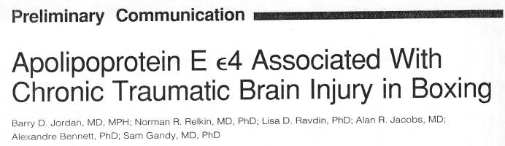
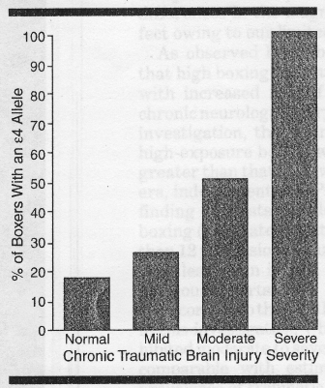
ApoE4 and Boxing
Percent of boxers with apoE4 was higher with increasing injury severity.
Among high exposure boxers, those with apoE4 had higher chronic brain injury scores.
Jordan, et al., JAM 2007
From C.C. Giza UCLA

Slide 38
Maastricht
A case study for genetic testing in sports
February 2009
Mario I. Sturla
President EBU Medical Commission
President Sports Medicine Association Pavia
Italian Sports Medicine Federation

Slide 39
Acute Brain Injury/concussion
To determine and compare the rate of recovery of memory and reaction time following concussion or subconcussion blows
To determine the influence of ApoE4 on rate of recovery of memory and reaction time

Slide 40
Hypothesis (Daniel Laskowitz*)
Inflammation (perhaps exacerbated by amyloid deposition) plays an important role in neuronal injury…. ApoE4 predisposes to inflammation, which causes neuronal injury and cognitive loss. Head injury associated with inflammation accelerates this process
* Duke University

Slide 41
“The brain is not metabolically quiescent; it has a tremendous demand for energy which must be satisfied at the risk of losing cells”
D.A.Hovda

Slide 42


Slide 43
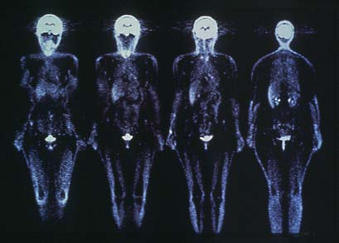
Cerebral blood flow and metabolism
2% of body weight
20% of cardiac output
20% of O₂ consumption

Slide 44
Potential relationships between oxidative and glucose metabolism following T.B.I.
Molar Oxygen-to-Glucose Ratio (OGR): Normal ~ 5.6
Post-T.B.I.
O₂
O₂
O₂
O₂
Glucose
O₂
Glucose
Glucose
Glucose
Glucose
Normal brain
Normal OGR
Hyperglycolysis
Low OGR
“Metabolic Depression” Normal OGR
?
High OGR

Slide 45
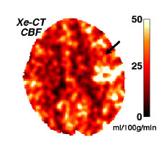
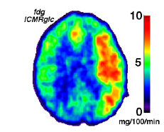
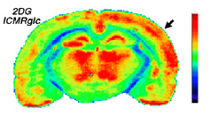
Metabolic perturbations:
Glucose and blood flow in rat and human
Increased brain glucose utilization following TBI
Decreased brain blood flow following TBI
UCLA Brain Injury Research Center

Slide 46
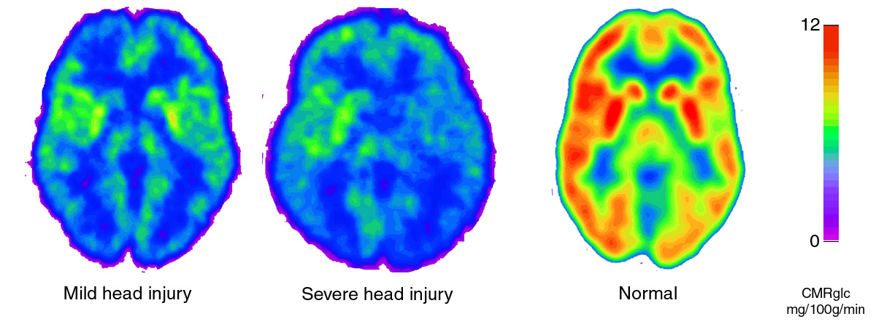
Decreased glucose metabolism after mild or severe human TBI
GCS 15
GCS 5
GCS 15
Bergsneider, Hovda, et.al. J Neurotrauma 2000

Slide 47
PREVENTION
TECHNIQUES
RESEARCH & ANIMAL MODELS
BIOMARKERS

Slide 48
Techniques
CT Scan
Magnetic Resonance Imaging (MRI)
Functional Magnetic Resonance Imaging (fMRI)
Diffusion Tensor Imaging (DTI)
Magnetic Resonance Spectroscopy (MRS)
Positron Emission Tomography (PET)

Slide 49
HISTORICAL BACKGROUND
NYSAC has been performing either CT or MRI scanning for more than 20 years
Why perform CT/MRI?
  Detect abnormalities that might increase immediate risk of injury in the ring
  Detect long-term or cumulative consequences of boxing
  Detect a neurological condition that be exacerbated by boxing

Slide 50
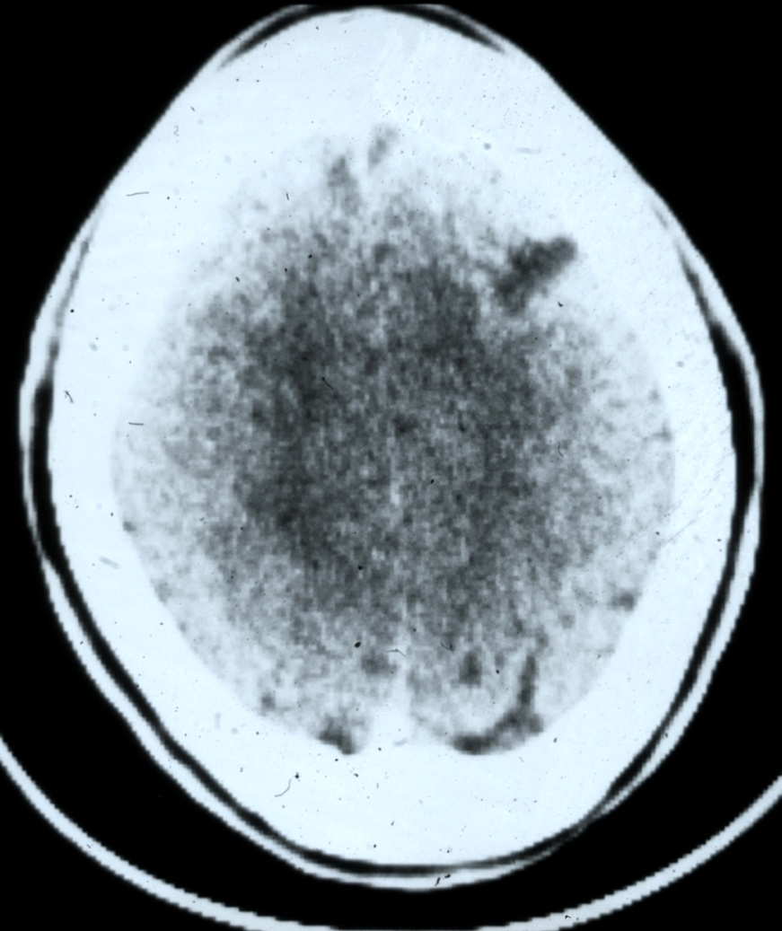
ACUTE HYPODENSE LESION
Boxer c/o headache after a boxing match
Pre-fight CT was normal
Post-fight CT a few days later demonstrated a new hypodense lesion

Slide 51
INCIDENTAL FINDINGS
Arachnoid Cysts
Arnold Chiari Malformations
Vascular Malformations

Slide 52
Diffusion Tensor Imaging
DTI is an advanced MRI technique that measures fractional anisotropy (FA), axial diffusivity, and radial diffusivity, which together help to characterize microstructural changes, in particular axonal integrity in vivo. It detects alterations in white matter architecture.
Fractional anisotropy and mean diffusivity have been shown to be sensitive markers for mild T.B.I.

Slide 53
White matter architecture JAMA, 2016
In sports like soccer, where a higher risk of brain trauma is present, compared to swimming, differences in white matter integrity have been found, even without a symptomatic concussion.
It is easy to infer that boxing, with its sudden acceleration and second impact probability, has to be taken into account.
The DTI study suggests possible demyelination.

Slide 54
PET
19 boxers c/w 8 normal controls SPM analysis
8 hypometabolic area
  Bilateral posterior parietal lobes that extended to the lateral occipital lobes
  Bilateral frontal lobes
  Bilateral cerebellar hemispheres
  Posterior cingulate cortex

Slide 55

W.B.C.
ARM
PET
Marker Hepatitis B - C
HIV
Genetic marker APOE₄
Weight

Slide 56
Weight
30 days before match: + 7 % allowed;
7 days before match: + 3 % allowed;
On this occasion: visit, plicometry, urines, Hct, electrolytes.

Slide 57
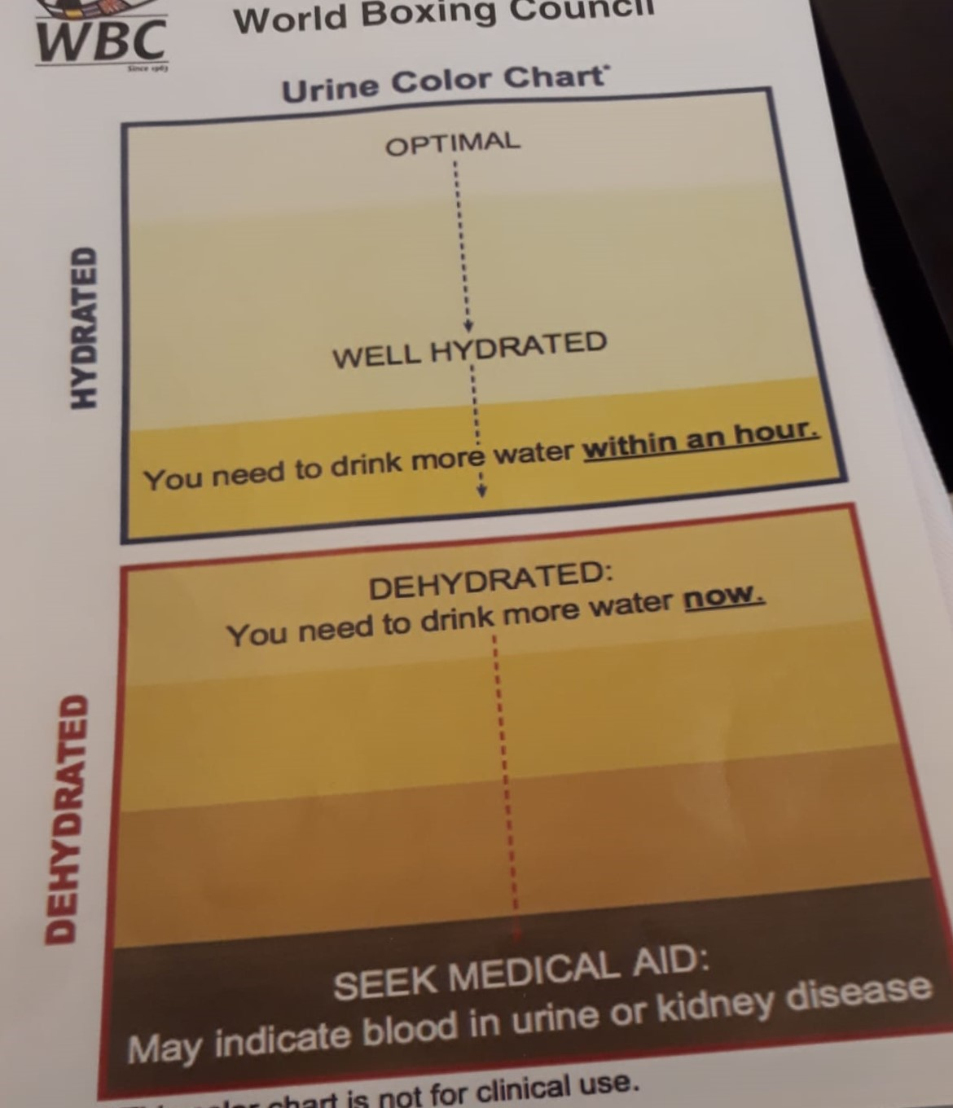

Slide 58

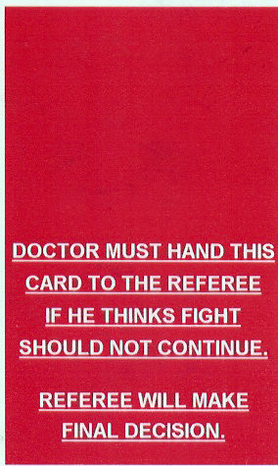
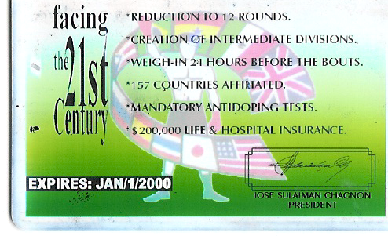

Slide 59
Experimental study on mice (2016)
The use of anabolic steroid hormones (e.g. nandrolone) worsen the effects of T.B.I., by causing axonal damage and microgliosis.
Previously (2013) another study had concluded that steroids may cause cognitive deficits (in visuo/spatial memory) even without T.B.I.

Slide 60
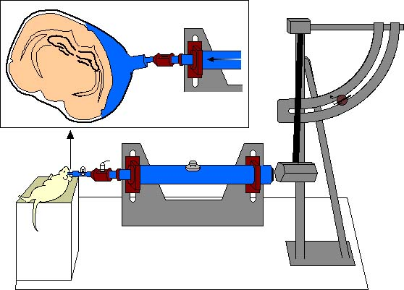
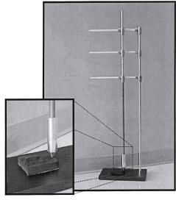
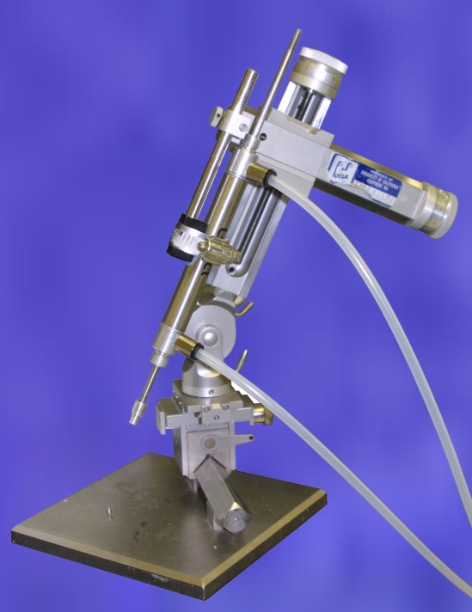
Animal Models of mild TBI (Concussion)
Fluid Percussion Injury (FPI)
1. Mild – yes
2. Diffuse – yes
3. Subtle deficits – yes
4. Closed – no
5. Repetitive – maybe
Injury
Cap
Saline filled cylinder
Transducer
Piston
Controlled Cortical Impact (CCI)
1. Mild – yes
2. Diffuse – maybe
3. Subtle deficits – yes
4. Closed – maybe
5. Repetitive – yes
Weight Drop (WD)
1. Mild – yes
2. Diffuse – yes
3. Subtle deficits – yes
4. Closed – yes
5. Repetitive – yes

Slide 61
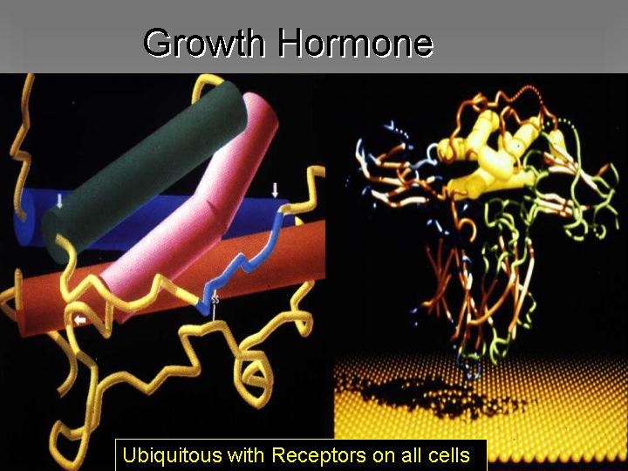

Slide 62
Second Impact Syndrome
Prevention of the Second Impact Syndrome (SIS) that appears when two T.B.I. occur in a short time span (hours or few days).
It is often lethal and affects mostly boxers and american football players.

Slide 63
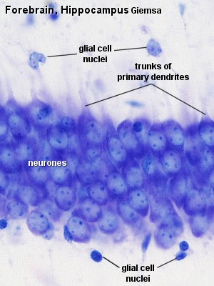
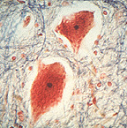
T.B.I. results in vulnerability
Early hypotension kills vital hippocampal cells leading to memory and cognitive problems

Slide 64
Br. J Sports Med. 2016
Review of the incidence of concussion in youth.
No boxing athletes included, but higher risk in rugby, hockey and american football.
Boxing probably has to be included by default.

Slide 65
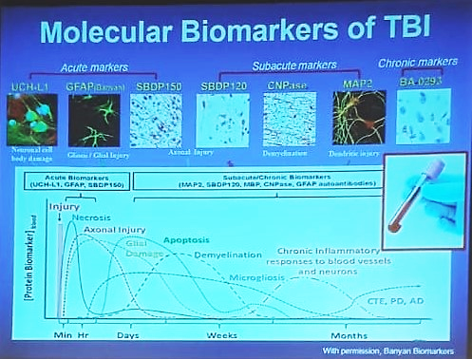

Slide 66

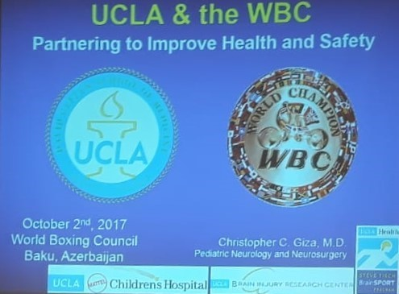

Slide 67
Biomarkers
S100-B, a regulator of intracellular calcium (blood and urine).
Glial fibrillary acidic protein (GFAP), a neurofilament protein.
The glycolytic enzyme, γ-enolase, also known as neuron-specific enolase (NSE), more effective in paediatric population.
BDNF (Brain Derived Neurotrophic Factor).
MicroRNAs (miRNAs regulating transcriptional gene expression) have also emerged as biomarker candidates (not yet assessed).

Slide 68
A new marker for TBI, JAMA 2016
A blood sample seems to be enough to detect the consequences of T.B.I.
GFAP may avoid CT scan and, nonetheless, detect a T.B.I. whose symptoms might be poor or late.
GFAP is Glial Fibrillary Acidic Protein, that increases its concentration when released by neurons following a damage. Accuracy of this test is 97 %.

Slide 69
J. Neurotrauma, 2015
BDNF (Brain Derived Neurotrophic Factor) is another blood marker to predict outcomes of T.B.I.
In this case the lower its concentration the higher the damage.
Administration of BDNF in emergency might help improving prognosis.

Slide 70
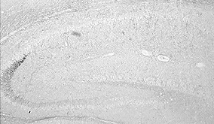
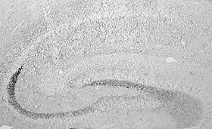
Exercise increases brain-derived neurotrophic factor (BDNF)
BDNF Sedentary
BDNF mRNA
BDNF 7 Days Exercise
Control
Exercise
Neeper et al., Nature, 373, 1995

Slide 71
Prevention with exercise?
Boxing includes a combination of factors (exercise, stress factors) that can be used to promote brain protection against further insults
Brain trauma affects neuronal function and has long-term effects on cognitive capacity
Can exercise and diet provide brain protection for the effects of trauma?

Slide 72
Clinical/Epidemiological
Studies of Exercise
Fitness training reduces cognitive decline associated with aging and increases brain volume in selected areas (Kramer, 2004, 2005).
Women engaged in exercise show less cognitive decline (Yaffe, 2005, Grodstein, 2005).
Individuals engaged in 4 or more types of physical activity have half the risk for AD (mainly for ApoE4 carriers, Lyketsos, 2005).

Slide 73
Round 2. DIET EFFECTS
Brain trauma promotes a period of reduced plasticity
Can omega-3 fatty acid dietary supplementation enhance the effects of exercise after T.B.I.?
Diet
Exercise

Slide 74
Neuropsychopharmacology, 2016
Thomas W McAllister et al.
Randomized Placebo-Controlled Trial of Methylphenidate or Galantamine for Persistent Emotional and Cognitive Symptoms Associated with PTSD and/or Traumatic Brain Injury.
Methylphenidate is a drug usually prescribed for treatment of attention-deficit hyperactivity disorder (ADHD), a typical child/adolescent pathology. It appears to improve post concussion symptoms and cognition.

Slide 75
JAMA Neurology 2016
An overview of older patients (about 80 years old) that had suffered for mild T.B.I., with loss of consciousness, reports that T.B.I. was not associated with mild cognitive impairment, Alzheimer’s disease or dementia, but rather with neurodegenerative and neuropathologic findings.
That is: Parkinson disease, Parkinsonisms and cerebral microinfarcts.

Slide 76
NEUROPSYCHOLOGICAL ASSESSMENT
Cognitive Domains Tests
Memory Hopkins
Attention Trail Making, Digit span
Language Boston Naming
Executive Function Rey Figure, selected WAIS
Psychomotor speed Selected WAIS
Premorbid IQ estimate Selected WAIS
Screen Mini Mental Status Exam

Slide 77

Differences ♀ vs. ♂
Higher fat mass
Smaller heart and lungs
Lower cardiac output
Lower pulmonary ventilation
Better articular mobility
Higher dexterity
Similar VO₂max if related to Fat Free Mass (only -12 %)

Slide 78

Fat free mass by age and gender

Slide 79
Neck muscles
There might be differences in postural tone of neck muscles between male and female.
A lower postural tone or a poor control may result in a greater risk of acceleration of the head with obvious consequences on the brain.

Slide 80
A safer boxing glove (C.Noble)
As punch maximum velocity is 9 to 16 m sec⁻¹ (32 to 58 km h⁻¹) and maximum acceleration is 30 to 110 m sec⁻², boxing gloves, until recently made of fibre, are now made of elastomeres (closed cell foams).
These substances, when compressed, return rapidly to their original shape, quickly (type 1) or slowly (type 2), with different energy absorption.

Slide 81
Peak punch force
Rotation and acceleration generate major brain injury and even death.
Rotational acceleration is measured in Radians sec⁻².
An acceleration over 4500 R sec⁻² will cause concussion, which is temporary brain disfunction with no permanent brain damage.
The level for severe brain damage is 18000 R sec⁻² .

Slide 82
A safer boxing glove (C.Noble)
The result of using these gloves is the production of a gradual rather than an instantaneous acceleration.
In fact, layering of this material in its two types – quick and low recovery – generates a composite laminate, balancing impact cushioning and energy absorption.

Slide 83
Emergency Equipment at the Ring during Bouts
a) a portable resuscitator or similar equipment in working order;
b) a stretcher under the ring apron for easy availability;
c) an ambulance parked in a freely accessible place outside the boxing arena for one (1) hour before and after the program, staffed with paramedics skilled in resuscitation;
d) a telephone at ringside only for the use of medical officers; a local hospital with an approved accident, emergency, and neurosurgical unit, as well as a neurosurgeon on call, must be under agreement.

Slide 84





NO ANSWER!!!
NO BREATH!!!
NO PULSE!!!
TIME IS NOT OUR FRIEND
112

Slide 85


DAE
portable resuscitator
Notes:
This is a new italian government decree: defibrillator mandatory in all sport venues.

Slide 86


LMA-Single Use
Disposable laryngeal device: sterile and ready to go!
Notes:
Another important tool lifesavers

Slide 87




THE USE OF LMA™
Is recommended by:
Resuscitation Council (UK)
American Heart
Association®
British Heart
Foundation
Fighting Heart Disease and Stroke
E
R
C
EUROPEAN
RESUSCITATION
COUNCIL

Slide 88




Display and Control
Sensor
Bluetooth link
Simple graphic display on a PDA indicates the presence and location of a haematoma.
Disposable shield facilitates maximum NIR penetration through human hair and eliminates cross contamination of bodily fluids.

Slide 89

HEADBORNE ENERGY ANALYSIS AND DIAGNOSTIC SYSTEMS
Military helmet with sensors to record and transmit biological signals.
Self activated by an explosion of a given power, it gives:
Time
Duration
Linear and angular accelerations
Pressure of the shock wave
Number of blows
Damaged areas of the helmet

Slide 90
WHAT IS TBI?
It is an injury to the brain caused by biomechanical force, it is not ischemia or stroke! These forces can be direct on indirect
It results in regional and temporal cellular alteration and may produce cell death.
It produces a state of energy crisis and subsequent metabolic diaschisis
It change the priorities for fuel
It can contribute to the acquisition of Post Traumatic Stress and more chronic neurological degeneration related to disease
Research - UCLA

Slide 91


Slide 92


Slide 93


Slide 94
Every year, a new era is starting!
It’s Really?

Slide 95

CARDIFF 2009

Slide 96

CONSTANTIN VAN MONAKOW
Swiss Neurologist of Russian Extraction
Diaschisis:
To distinguish between the transient central nervous disorders due to suppression of brain activity and the deficits resulting from brain lesions never disappear
1853 - 1930
Research - UCLA

Slide 97
THE FUTURE OF THE MEDICINE
“PRECISION MEDICINE”

Slide 98


Slide 99
TAKE HOME MESSAGE:
PREVENTION
PREVENTION
PREVENTION

Slide 100


Slide 101


Slide 102

ANY QUESTION?????
THANK YOU!

